Slide 1
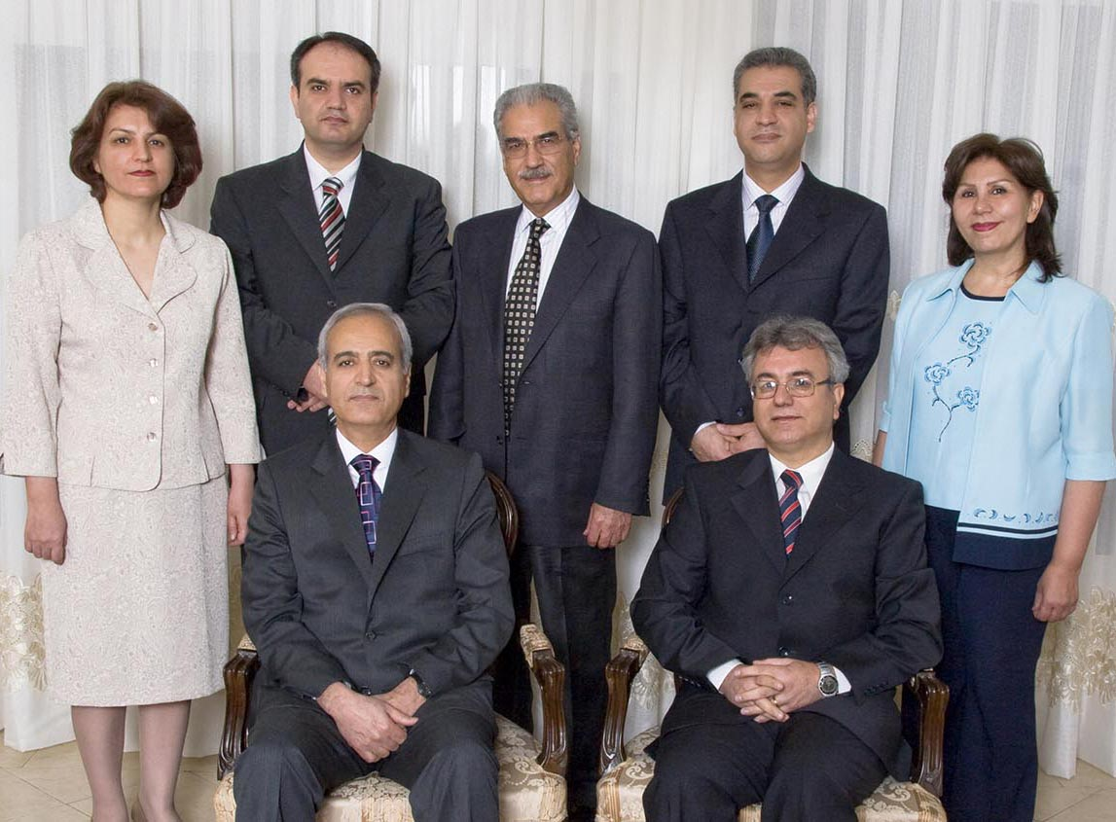
LIVES OF SERVICE
Profiles of Seven Imprisoned Bahá’ís

Slide 2


YÁ BAHÁ’U’L-ABHÁ
O Thou the Glory of Glories
(Used as an invocation)

Slide 3
God is Sufficient
God is sufficient unto me.
He verily is the All-Sufficing.
In Him let the trusting trust.
In Him let the trusting trust.

Slide 4
LIVES OF SERVICE

Slide 5
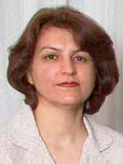
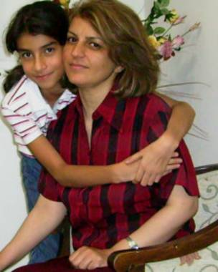
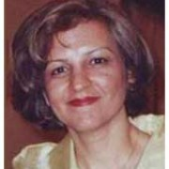
Mrs.
Fariba
Kamalabadi
Arrested May 14, 2008
at her home in Tehran

Slide 6
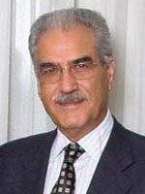
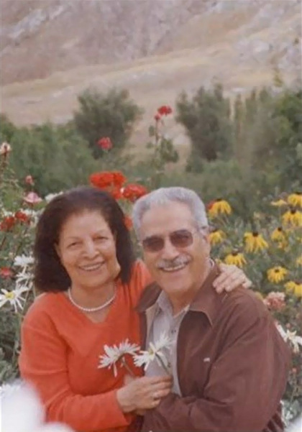
Mr.
Jamaloddin
Khanjani
Arrested May 14, 2008
at his home in Tehran

Slide 7
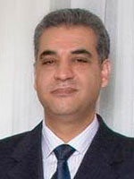
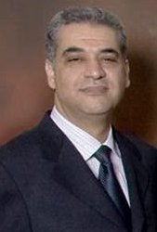
Mr.
Afif
Naeimi
Arrested May 14, 2008
at his home in Tehran

Slide 8
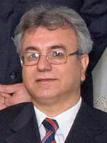
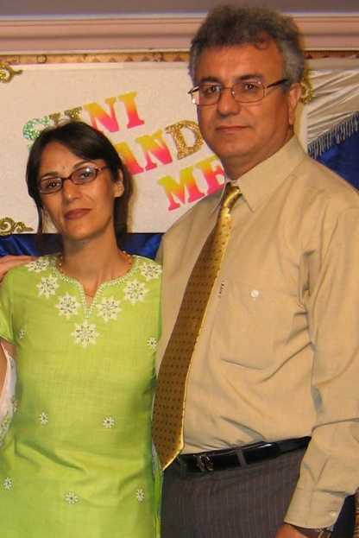
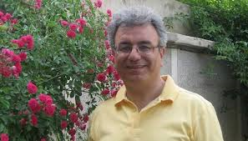
Mr.
Saeid
Rezaie
Arrested May 14, 2008
at his home in Tehran

Slide 9
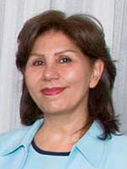
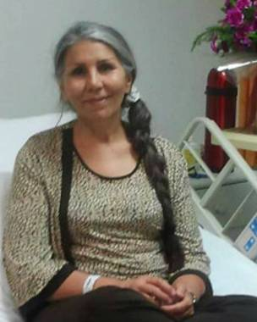
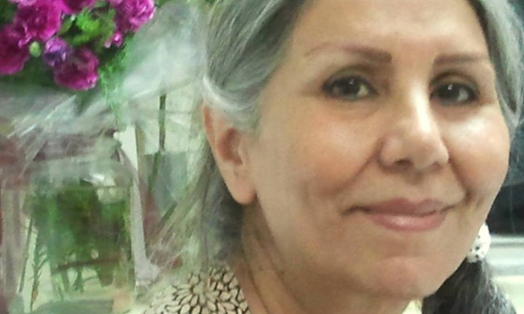
Mrs.
Mahvash
Sabet
Arrested in Mashhad
on March 5, 2008

Slide 10
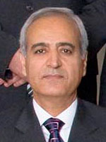
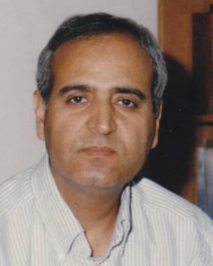
Mr.
Behrouz
Tavakkoli
Arrested 14 May 2008
at his home in Tehran

Slide 11
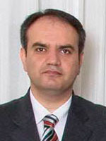
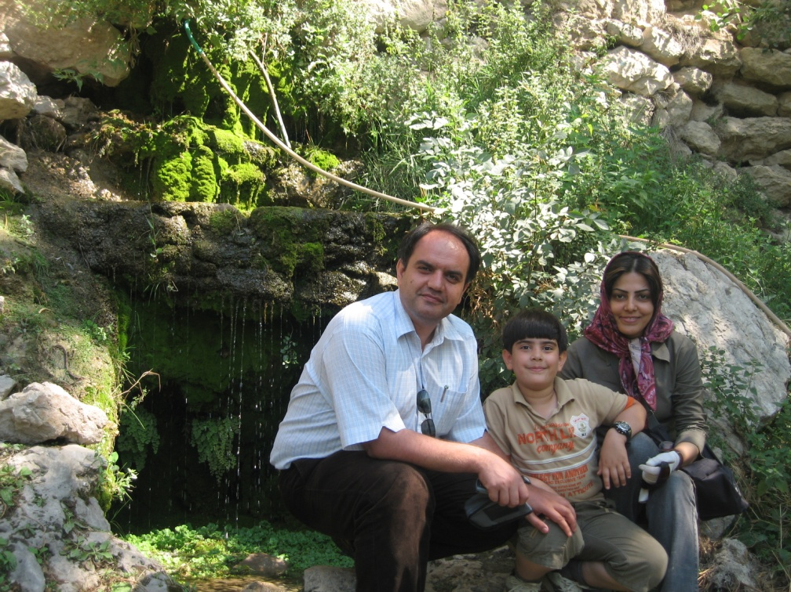
Mr. Vahid
Tizfahm
Arrested 14 May 2008
at his home in Tehran

Slide 12
Yaran
You Are Remembered
And Not Forgotten!

Slide 13
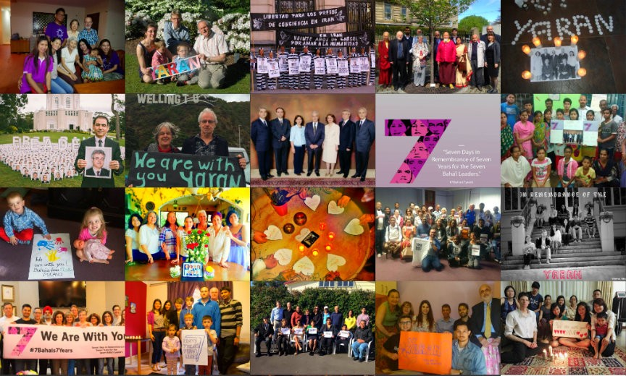
Yaran
You Are Remembered And Not Forgotten!

Slide 14
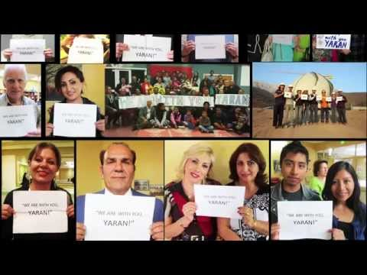
Yaran
You Are Remembered And Not Forgotten!

Slide 15

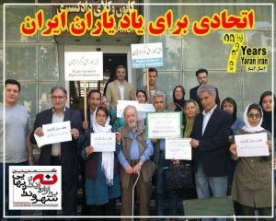
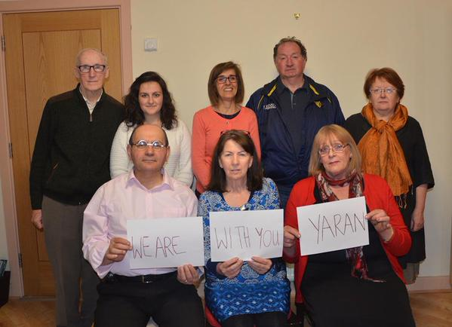
Yaran
You Are Remembered
And Not Forgotten!

Slide 16
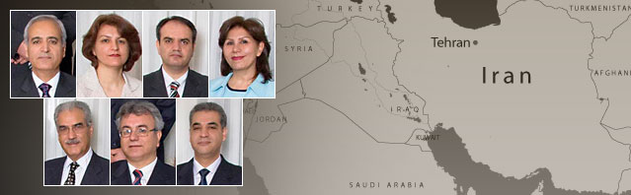
Yaran
You Are Remembered And Not Forgotten!

