Slide 1

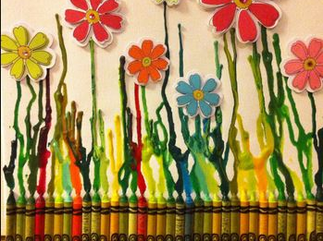
Art
is an Act of Spirituality

Slide 2

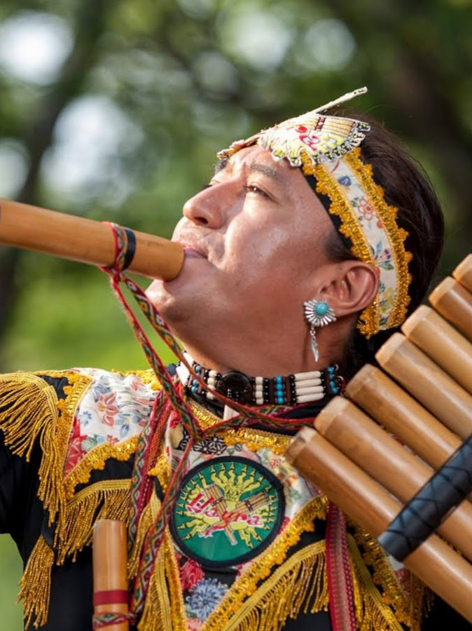
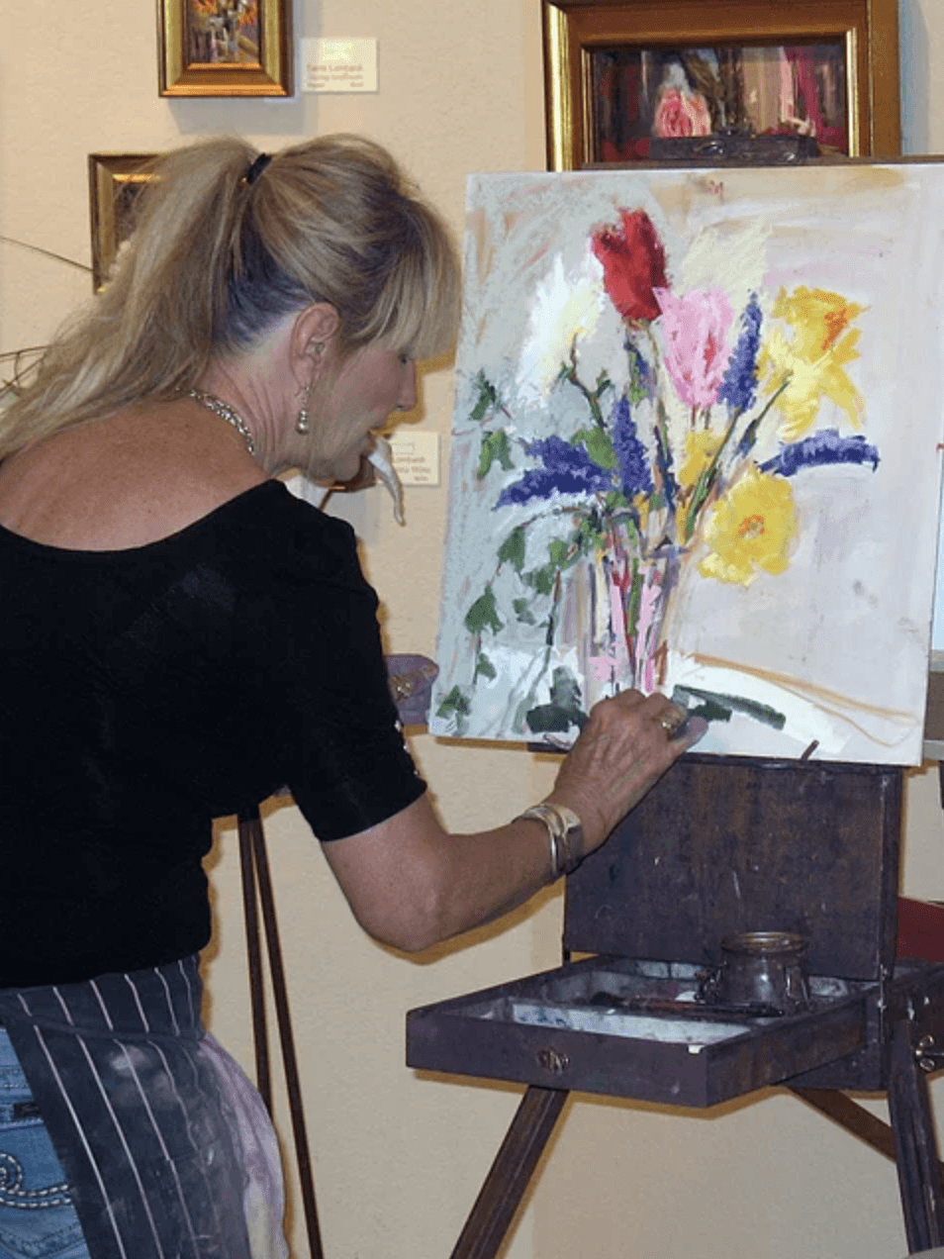
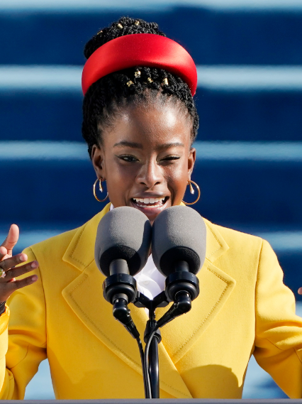
All Art is a gift of the Holy Spirit. When this light shines through the mind of a musician, it manifests itself in beautiful harmonies. Again, shining through the mind of a poet, it is seen in fine poetry and poetic prose. When the Light of the Sun of Truth inspires the mind of a painter, he produces marvelous pictures. These gifts are fulfilling their highest purpose when showing forth the praise of God.
‘Abdu'l‑Bahá

Slide 3
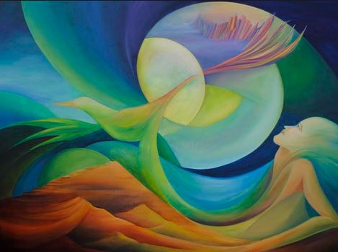
I myself do nothing. The Holy Spirit accomplishes all through me.
William Blake

Slide 4
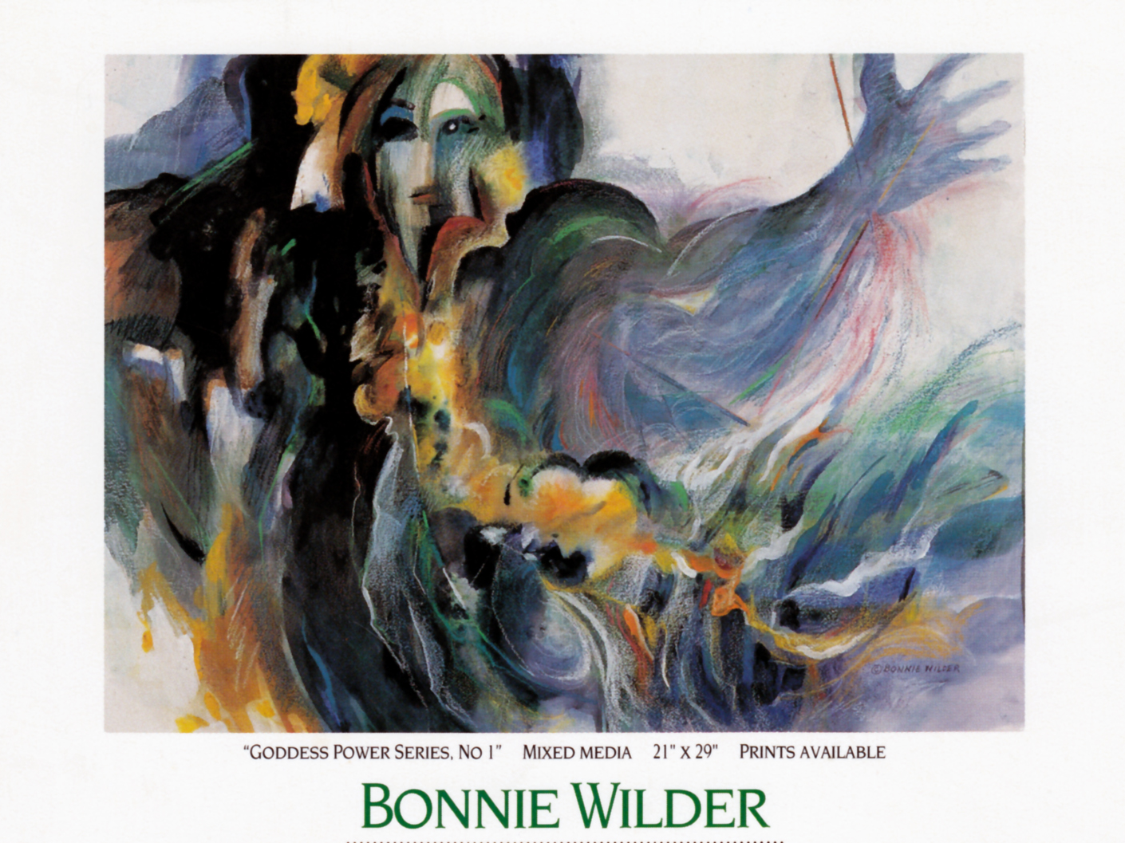

...arts, crafts and sciences uplift the world of being,
and are conducive to its exaltation. ~ Bahá’u’lláh

Slide 5


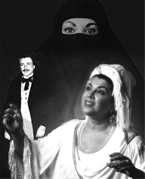
...theatre artists are not just entertainers: they are shamans, who serve as intermediaries between spiritual realities and audiences.
Hannah Sachs

Slide 6
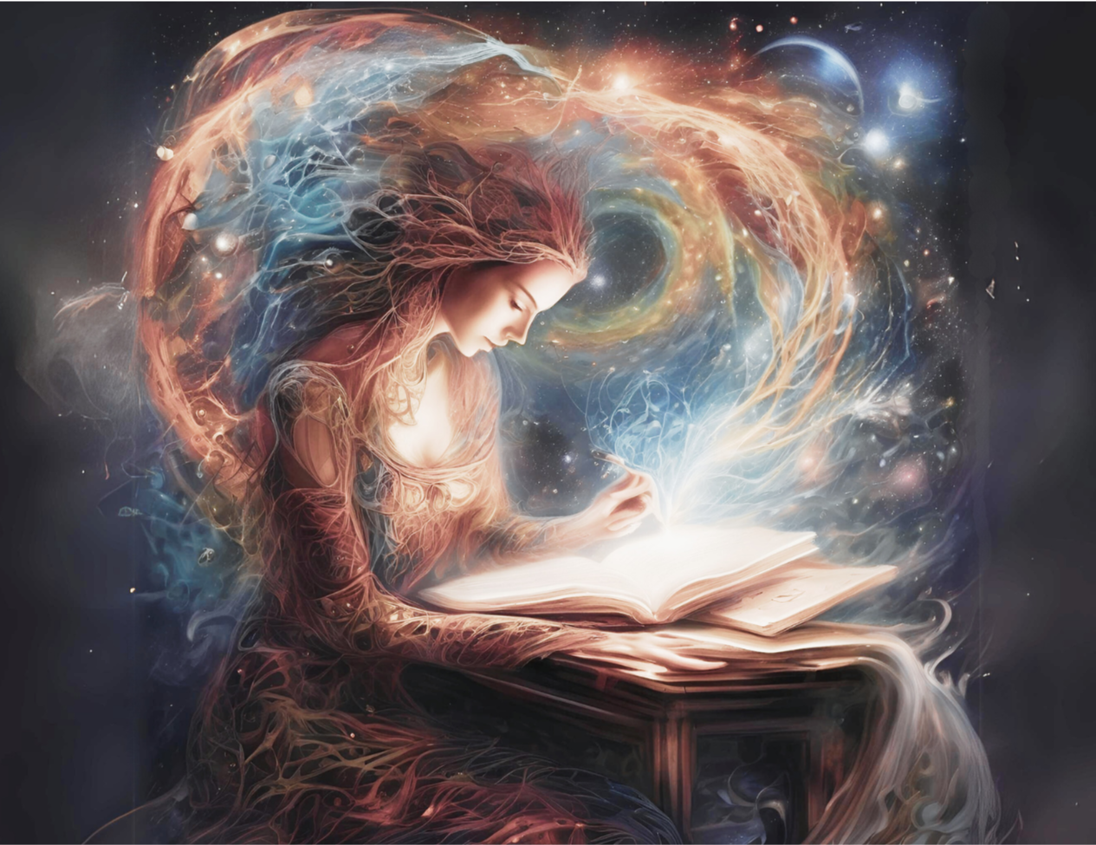
Colleen
Grace
Clabby
As divine spiritual human beings and writers, we are always traveling in our hearts and minds, guided by our writing muse. Every thought has energy, every breath carries memory. And every word that we write becomes a testament to our soul’s journey.
Writing is more than just words on a page. It represents a profound connection with our deepest self, our experiences, and the surrounding universe.

Slide 7
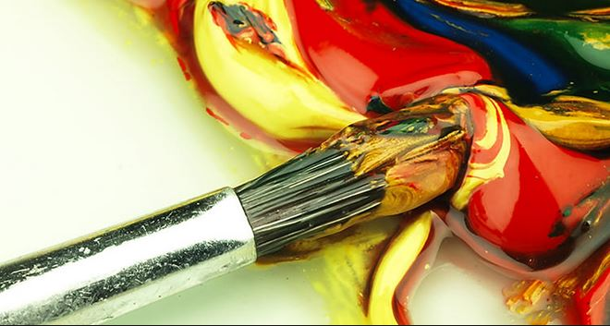
Henry
Ward
Beecher
Every artist dips his brush in his own soul and paints his soul into his pictures.

Slide 8
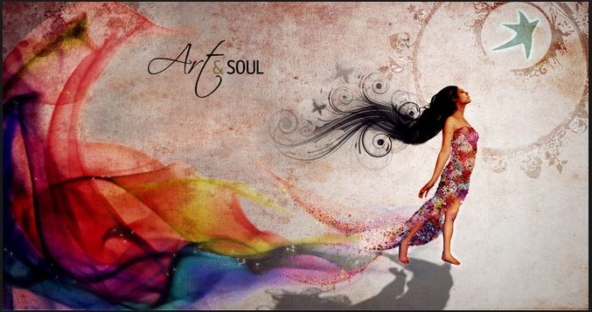
Art is when you hear a knocking from
your soul — and you answer.
Terri Guillemets

Slide 9
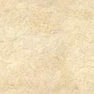
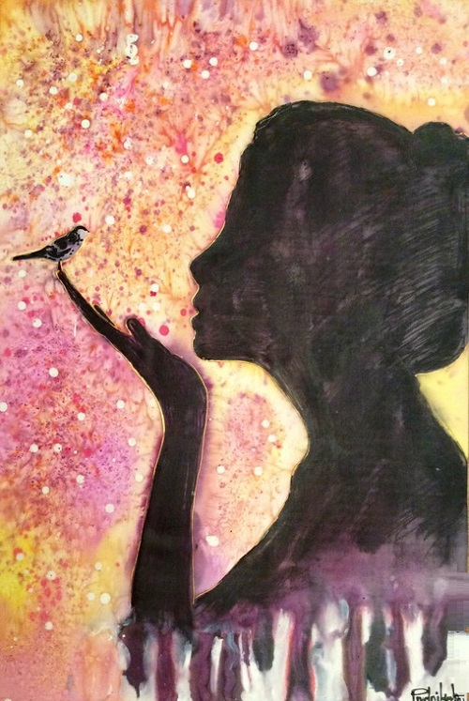
Treasures lie hidden beneath the throne of God; the key to those treasures is the tongue of poets.
The Báb

Slide 10
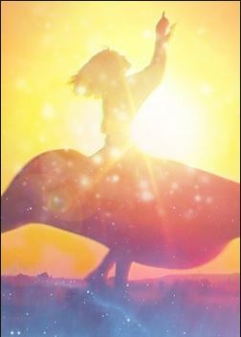
Every child has known God.
Not the God of names,
Not the God of don’ts,
Not the God who ever does anything weird,
But the God who knows only four words
and keeps repeating them, saying,
“Come dance with me,
come dance.”
Hafiz

Slide 11
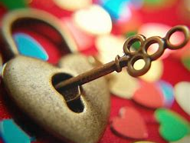
The function of language is to portray the mysteries and secrets of human hearts. The heart is like a box, and language the key. Only by using the key can we open the box and observe the gems it contains.
‘Abdu’l-Bahá

Slide 12
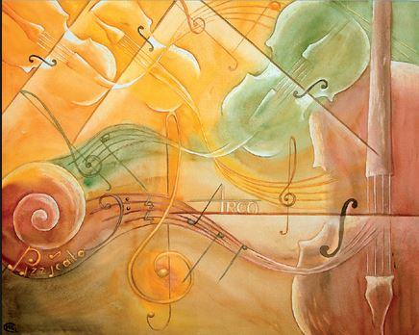
Bach gave us God’s Word.
Mozart gave us God’s Laughter.
Beethoven gave us God’s fire.
God gave us music that we might pray without words.
Sign outside an old opera house

Slide 13

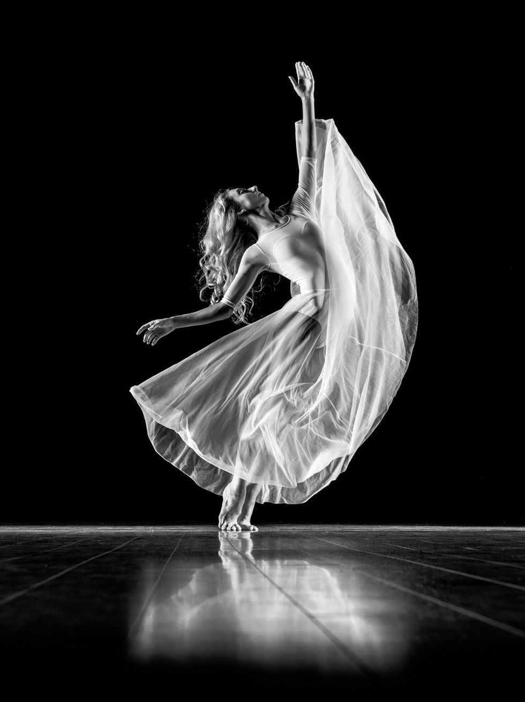
Dance is prayer — when you don’t have the words to say, simply dance, and your heart will express the things that words cannot.
La'Toya Princess Jackson

Slide 14
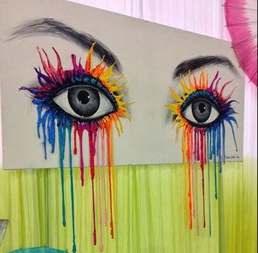
Life beats down and crushes the soul and art reminds you that you have one.
Stella
Adler

Slide 15
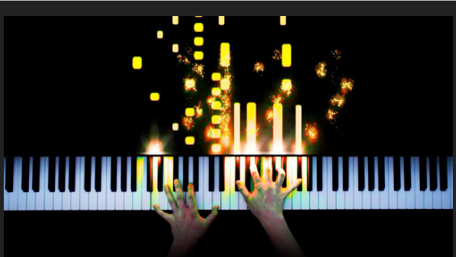
Prayer is when you talk to God. Meditation is when you’re listening. Playing the piano allows you to do both at the same time. – Kelsey Grammer

Slide 16
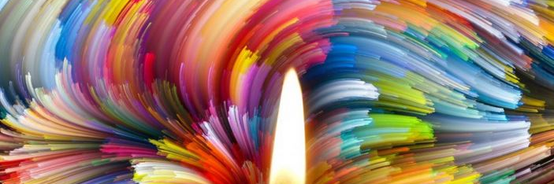
I learned that the real creator was my inner Self,...That desire to do something is God inside talking through us.
Michele Shea

Slide 17
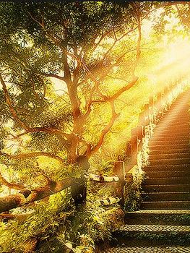
Human reasoning is born from the divine Logos, which furnishes each man with the passageway both of life and of nourishment.
The divine Logos is present in all the arts, ever teaching men what they must do to obtain good results. For it is not man, but God, who discovered the arts.
Epicharmus of Syracuse

Slide 18
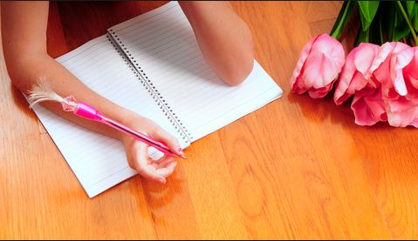
We should write because humans
are spiritual beings
and writing is a powerful form
of prayer and meditation.
Julia Cameron

Slide 19
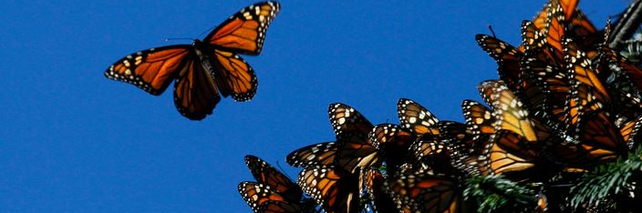
The light which these souls [the sincere and faithful beings who have passed into the next realm] radiate is responsible for the progress of the world and the advancement of its people. They are like unto leaven which leaveneth the world of being and constitute the animating force through which the arts and wonders of the world are made manifest.
Bahá’u’lláh

Slide 20
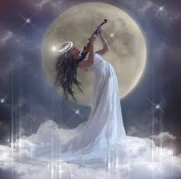
When music of this world is blended with that of the Kingdom, men's hearts will be so enraptured that their spirits will soar high with ecstasy.
‘Abdu’l-Bahá’

Slide 21
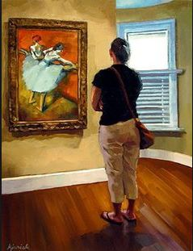
You use a glass mirror to see your face; you use works of art to see your soul.
George Bernard Shaw

Slide 22
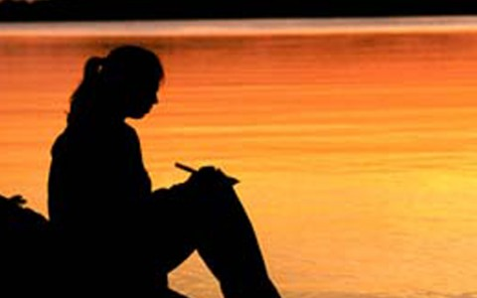
God gives me the words, and I put them on paper.
Jan Phillips

Slide 23
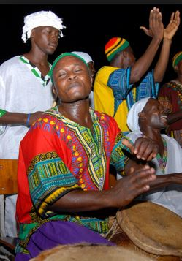
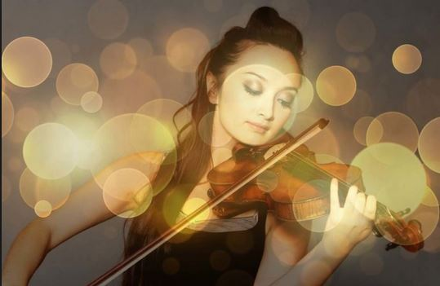
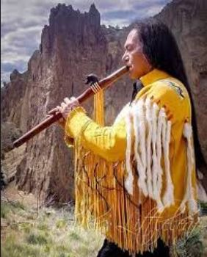
Thomas
Carlyle
Music is well said to be the speech of angels; in fact, nothing among the utterances allowed to man is felt to be so divine. It brings us near to the infinite.

Slide 24
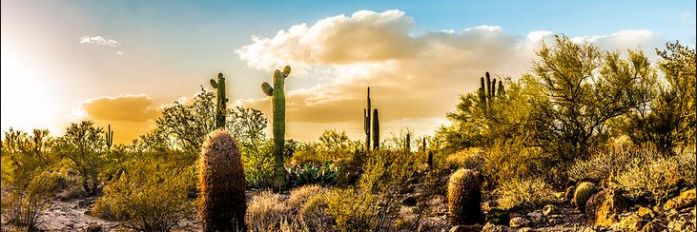
[B]oth natural and artistic beauty is capable of evoking what is called the sense of transcendence, or the presence of some deeper (divine) principles in the world.
O. Bychkov

Slide 25
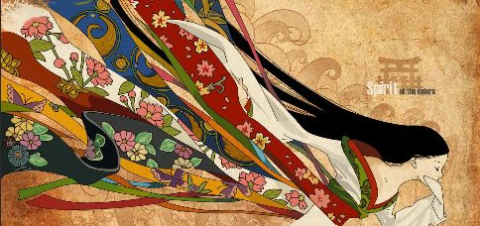
Art and beauty are immediately pleasing…the rules and principles of art are beyond us or transcend us: possibly indicating the presence of a higher principle (e.g., the divine) in the universe. The arts are used for these purposes by most religious traditions...
O. Bychkov

Slide 26
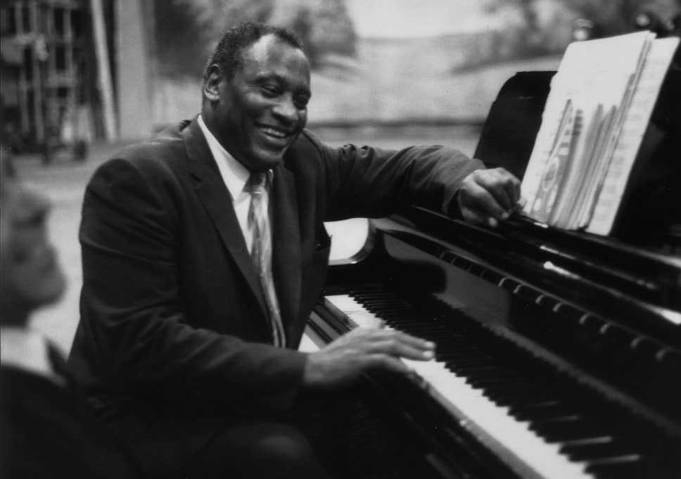
The talents of an artist, small or great, are God-given. They've nothing to do with the private person; they're nothing to be proud of. They're just a sacred trust...Having been given, I must give. Man shall not live by bread alone, and what the farmer does I must do. I must feed the people—with my songs.
Paul Robeson

Slide 27
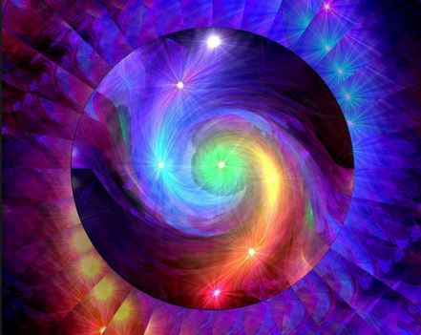
Julia
Cameron
Our creative dreams and yearnings come from a divine source.
As we move toward our dreams, we move toward divinity.

Slide 28
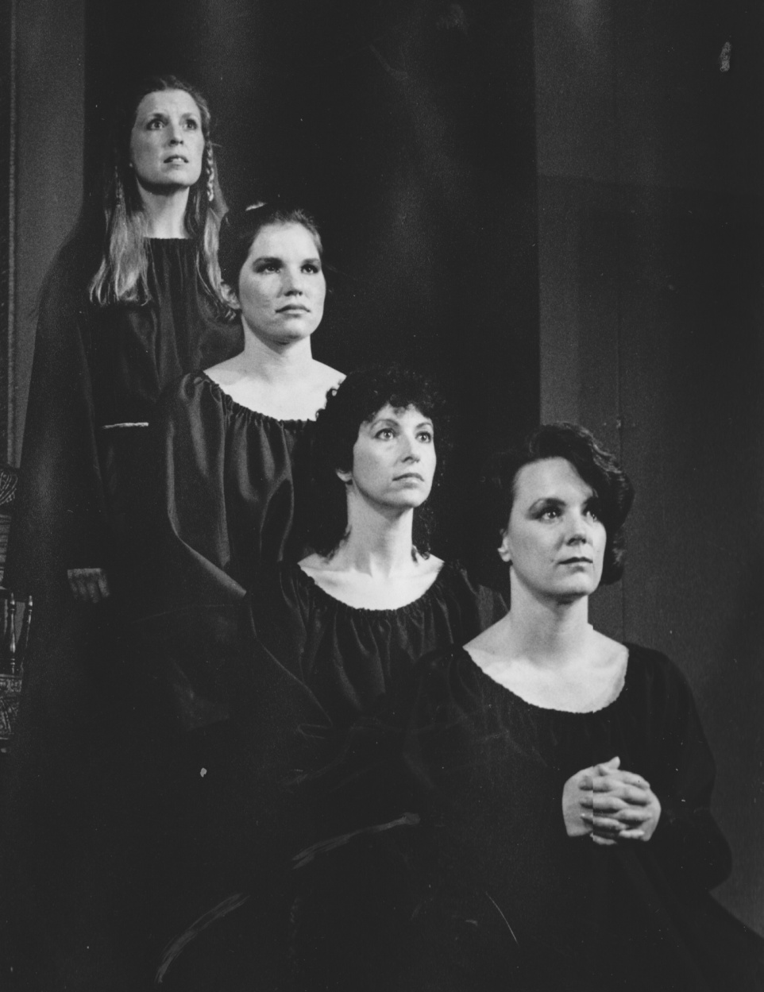
Theatre is my temple and my religion and my act of faith. Strangers sit in a room together and believe together.
Harvey Fierstein

Slide 29
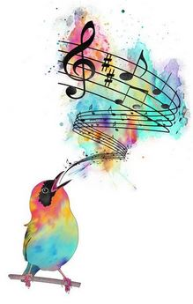
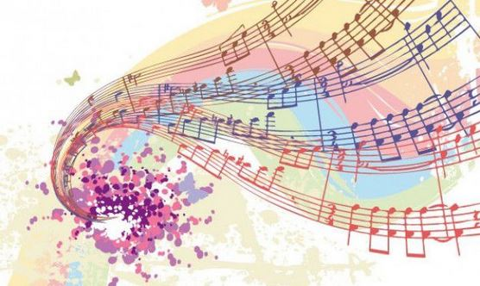
There is nothing in the world so much like prayer as music is.
William P. Merrill

Slide 30
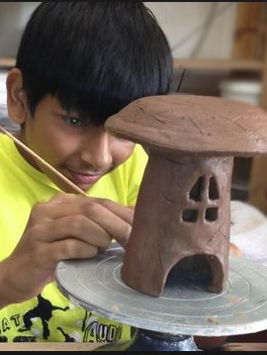
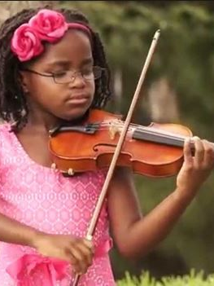
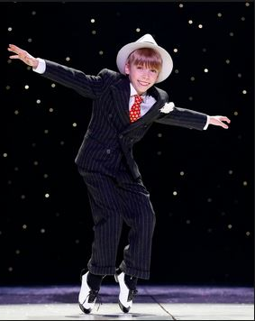
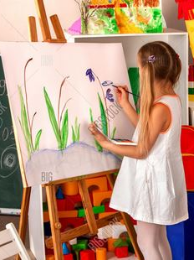
Encourage the children from their earliest years to master every kind of learning, and make them eager to become skilled in every art—the aim being that through the favouring grace of God, the heart of each one may become even as a mirror disclosing the secrets of the universe, penetrating the innermost reality of all things . . .
‘Abdu’l-Bahá

Slide 31
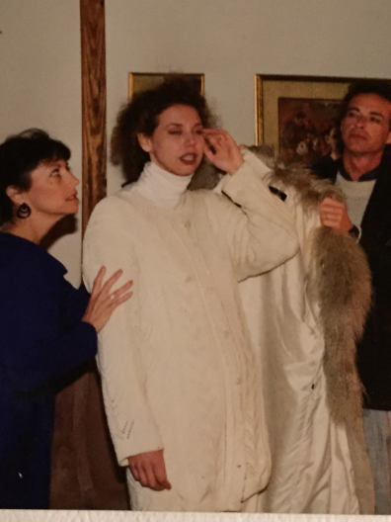
It is through you, actors, that the forces which are understood by millions and that tell of everything that is beautiful on earth, find expression. The forces which reveal to people the happiness of living in a widened consciousness and in the joy of creative work for the whole world. You, the actors of a theatre, which is one of the centres of human culture, will never be understood by the people if you are unable to reflect the spiritual needs of your time, the now in which you are living.
Konstantin Stanislavski

Slide 32
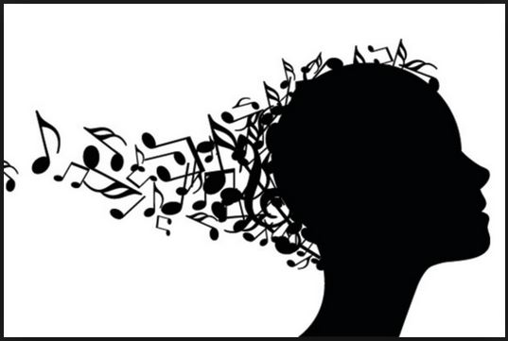
Straightway the ideas flow in upon me, directly from God.
Johannes Brahms

Slide 33
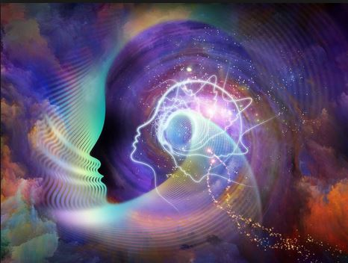
Joseph
Joubert
Imagination is the eye of the soul.

Slide 34
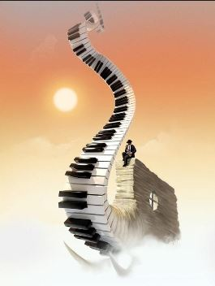
We have made music a ladder by which souls may ascend to the realm on high.
Bahá'u'lláh

Slide 35
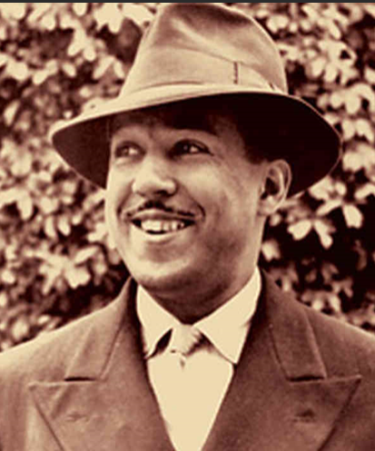
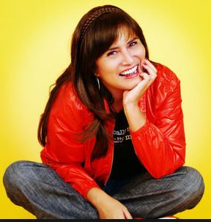
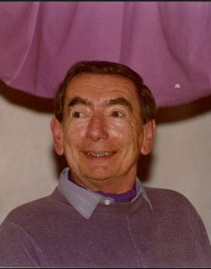
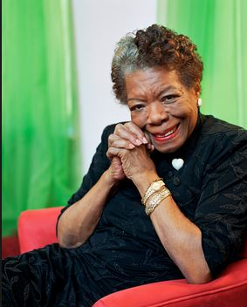
Langston Hughes
Michele Serros
Roger White
Maya Angelou
The poet's eye, in a fine frenzy rolling,
Doth glance from heaven to earth, from earth to heaven;
And as imagination bodies forth
The forms of things unknown, the poet's pen
Turns them to shapes, and gives to airy nothing
A local habitation and a name.
William Shakespeare

Slide 36
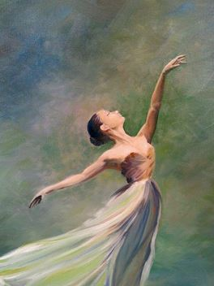
Creativity
requires faith.
Faith requires
that we
relinquish control.
Julia Cameron

Slide 37
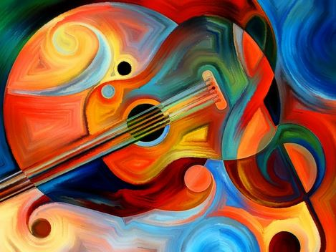
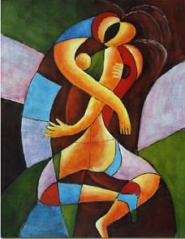

Art washes away from the soul the dust of everyday life.
Pablo Picasso

Slide 38

Gandhi
All true art must help the soul to realize its inner self...
true art must be evidence of the happiness,
contentment, and purity of its authors.

Slide 39

...an appreciation of beauty is one of the spiritual forces that lifts us to higher realms of existence. To strengthen this power of attraction it is beneficial for the friends to be exposed to various forms of art.
The Bahá’í International Teaching Centre

Slide 40

Every creative process demands great concentration of the artist’s spiritual forces.
Konstantin Stanislavski

Slide 41


Dance comes through the eyes, then the mind
and into the heart.
Bill T. Jones

Slide 42




Art is a collaboration between God and the artist, and the less the artist does the better.
André Gide

Slide 43




Music gives a soul to the universe, wings to the mind, flight to the imagination, and life to everything.
Plato

Slide 44

Alexander
Pope
To wake the soul by tender strokes of art,
To raise the genius, and to mend the heart;
To make mankind, in conscious virtue bold,
Live o'er each scene, and be what they behold:
For this the Tragic Muse first trod the stage.

Slide 45










Dance is imagination brought to life! Dance is prayer. Dance is meditation. Dance is walking through the clouds, flying among the stars, gliding on the moon and experiencing the pure bliss of heaven on earth.
~ La'Toya Princess Jackson

Slide 46


True painting is only the image of the perfection of God.
~Michelangelo

Slide 47



Art, as far as it is able, follows nature,
as a pupil imitates its master;
thus your art must be, as it were, God’s grandchild.
Dante Alighieri

Slide 48



When anyone occupieth himself in a craft or trade, such occupation itself is regarded in the estimation of God as an act of worship.
Bahá'u'lláh

Slide 49


It is the immediate influence of the Holy Spirit that causes words such as these (lines from Hafiz) to stream from the tongue of poets, the significance of which they themselves are oftentimes unable to apprehend.
~ The Báb ~

Slide 50

…when thy fingers grasp the paintbrush, it is as if thou wert at prayer in the Temple.
~ ‘Abdu'l-Bahá ~

Slide 51

All great art is the work of the whole living creature, body and soul, and chiefly of the soul.
John Ruskin

Slide 52

Kate Santich
If you are lucky and reverent, and hush for a moment the voices of doubt in your head, sometimes God will whisper in your ear.

Slide 53

SING!
Not to perform—
just to worship.
Eric Dozier

Slide 54


The music of this opera [Madame Butterfly] was dictated to me by God; I was merely instrumental in putting it on paper and communicating it to the public.
Puccini

Slide 55

Albert
Einstein
The most beautiful thing we can experience is the mysterious.
It is the source of all true art and science.

Slide 56



A wondrous melody is wings for the spirit,
and maketh the soul to tremble for joy.
‘Abdu'l‑Bahá

Slide 57

Prayer is simply a conversation with God… dance provides an internal dialogue that is sacred within your heart, soul and spirit—giving you a direct line to the source.
La'Toya Princess Jackson

Slide 58

The Theatre is magic, and blessed are those who make that magic. ~ Author Unknown

Slide 59





Dance is the hidden language of the soul.
Martha Graham

Slide 60





The art of building, or architecture, is the beginning of all the arts that lie outside the person; and in the end they unite.
Havelock Ellis

Slide 61




When we open ourselves to our creativity,
we open ourselves to the Creator’s creativity
within us and our lives.
Julia Cameron

Slide 62

The poet is the priest of the invisible.
Wallace Stevens

Slide 63






Don’t only practice your art, but force your way into its secrets, for it and knowledge can raise men to the divine.
Ludwig Von Beethoven

Slide 64

First, one seeks to become an artist by training the hand. Then one finds it is the eye that needs improving. Later one learns it is the mind that wants developing, only to find that the ultimate quest of the artist is in the spirit.
Larry Brullo

Slide 65

Endeavor your utmost to compose beautiful poems to be chanted with heavenly music; thus may their beauty affect the minds and impress the hearts of those who listen.
‘Abdu’l-Bahá

Slide 66

I paint not by sight but by faith.
Faith gives you sight.
Amos Ferguson

Slide 67

Art deals with things forever incapable of definition that belong to love, beauty, joy and worship. The shapes, powers and glory of which are ever building, unbuilding and rebuilding in each man's soul and in the soul of the whole world.
Plotinus

Slide 68

[I]n this wonderful new age, art is worship. The more thou strivest to perfect it, the closer wilt thou come to God.
‘Abdu'l‑Bahá

Slide 69


That is beautiful which is produced by the inner need, which springs from the soul.
Wassily Kandinsky

Slide 70


Music,
sung or played,
Is spiritual food
for soul and heart.
‘ Abdu'l‑Bahá

Slide 71

Practicing an art, no matter how well or how badly, is a way to make your soul grow, for heaven’s sake.
Kurt Vonnegut

Slide 72

Creativity is God’s gift to us.
Using our creativity is our gift back to God.
Julia Cameron

Slide 73

Joseph
Chilton
Pearce
We must accept that this creative pulse within us
is God’s creative pulse itself.

Slide 74

Holy Creator,
thank you for artists:
visual, verbal,
musical, kinesthetic,
spiritual . . .
Within their creative process
may we recognize
the divine in all creation
and be moved to awe
and wonder and worship.
Chris Glaser

Slide 75
Art
is an Act of Spirituality

