Slide 1

Amazing Grace
Stories of Personal Transformation
from Slavery to the Present Day

Slide 2


Slide 3


Slide 4

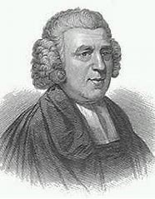
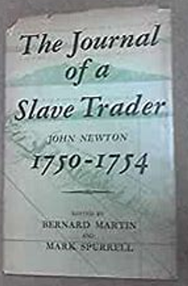
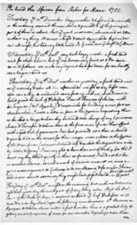
The Story of John Newton
~Part 1 ~

Slide 5
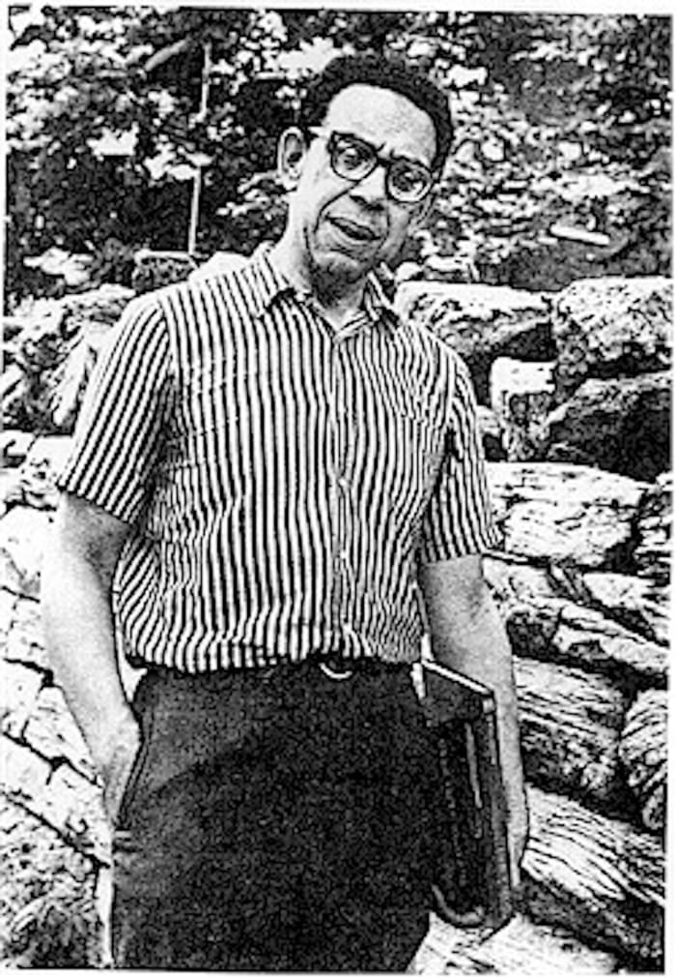
Middle Passage
by Robert Hayden

Slide 6
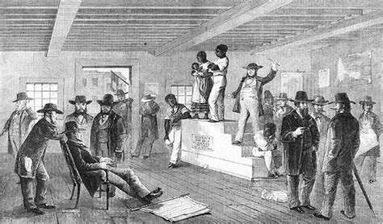
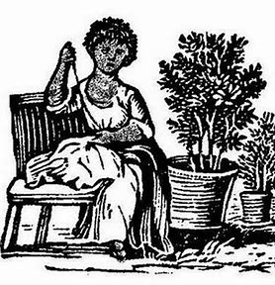
Trading of Enslaved Females

Slide 7
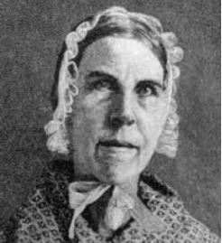
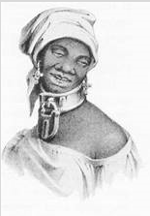
Testimony of Sarah Grimke
South Carolina Abolitionist

Slide 8

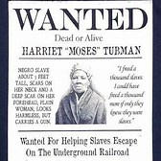
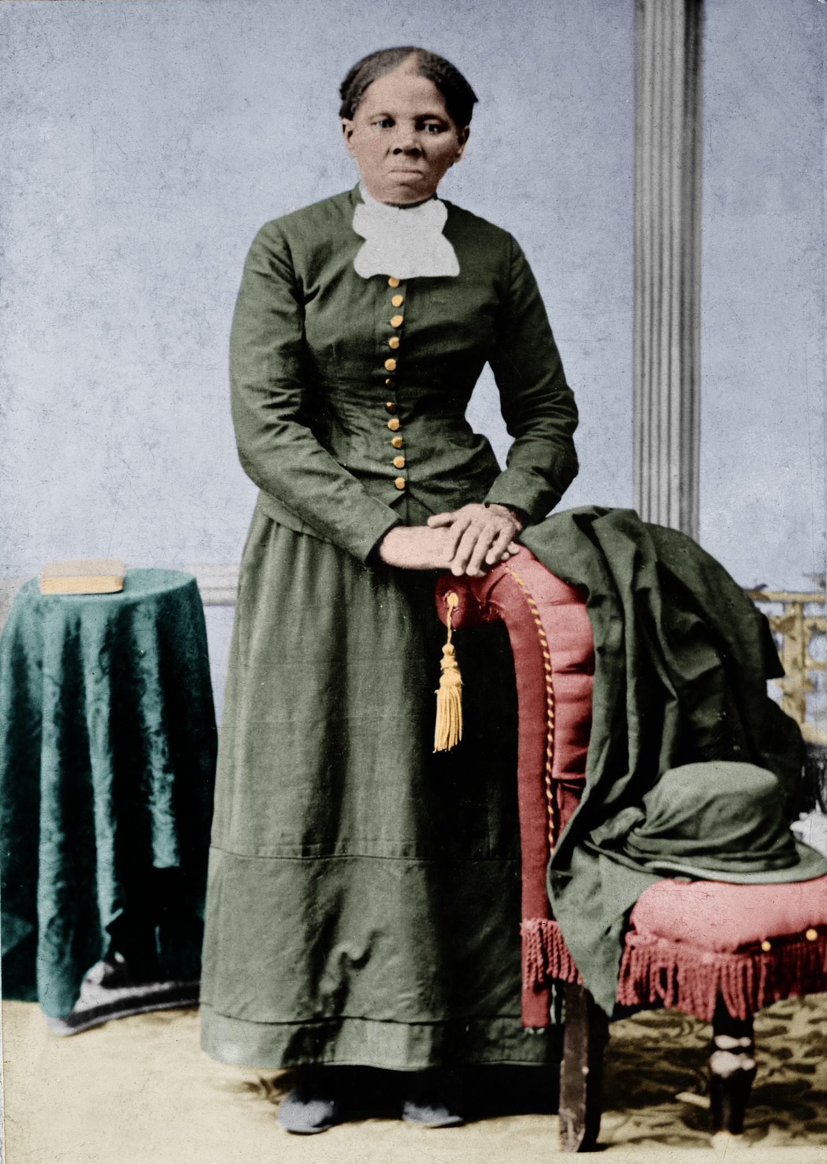
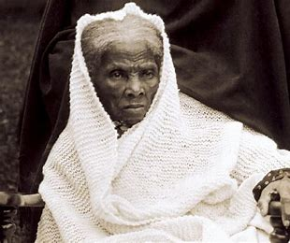
She Had A Dream:
The Story of Harriet Tubman by Terre Ouwehand

Slide 9

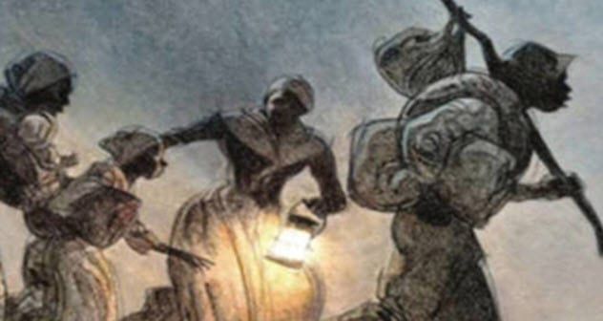
Runagate, Runagate by Robert Hayden

Slide 10

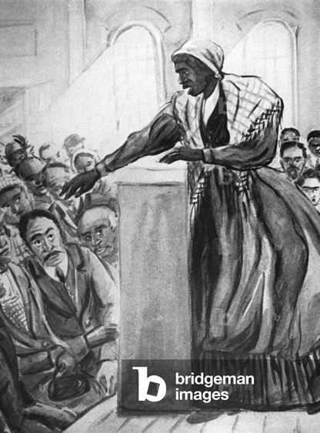
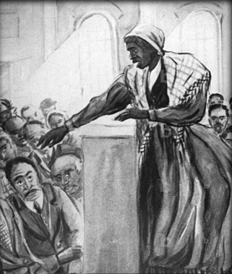
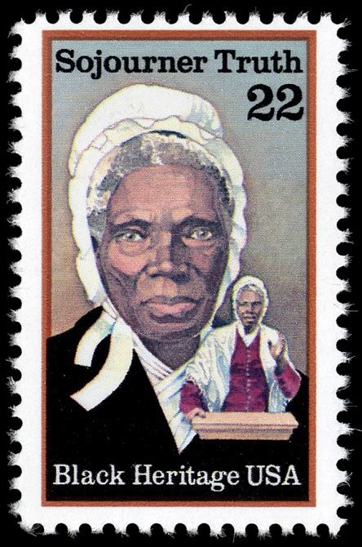
Sojourner Truth

Slide 11
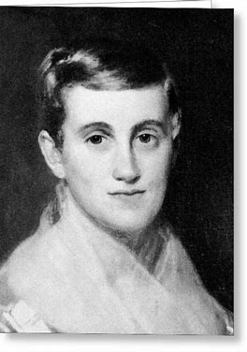
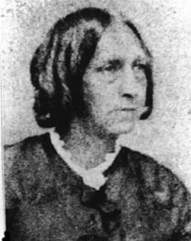

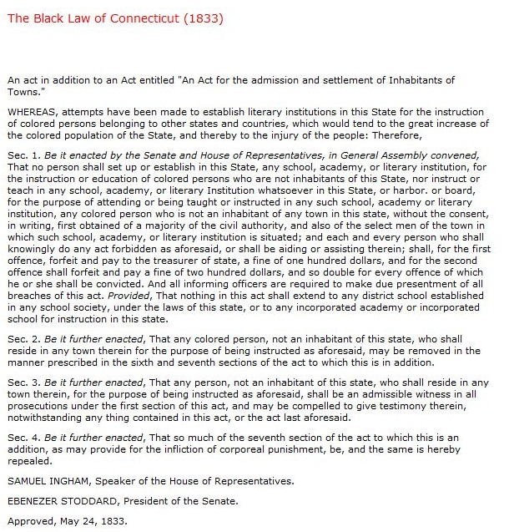
Excerpts from
A Whole-Souled Woman:
Prudence Crandall and the Education of Black Women by Susan Strane
Sarah Harris

Slide 12
Intermission

Slide 13
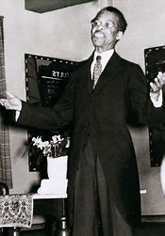
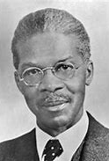

A Story About Louis G. Gregory excerpted from

Slide 14
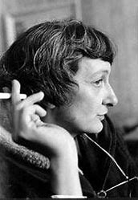
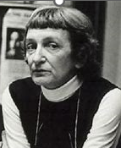
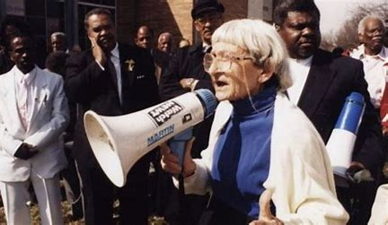
The Wall Between the Story of Anne Braden

Slide 15
The Story of John Newton
~Part 2 ~

Slide 16
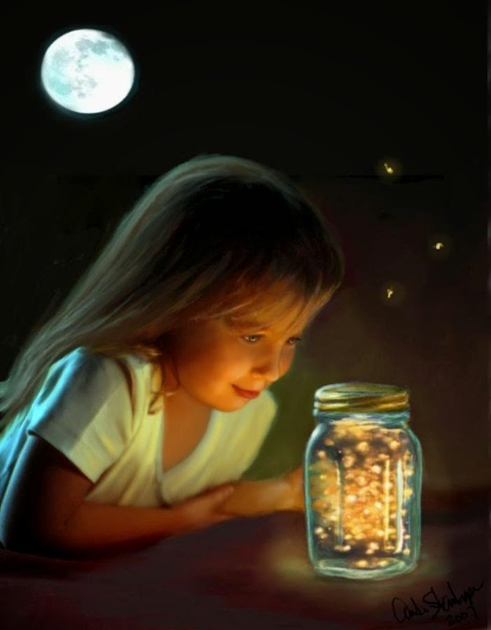
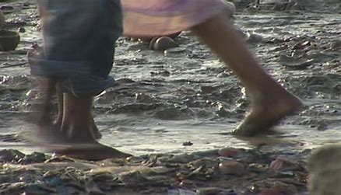
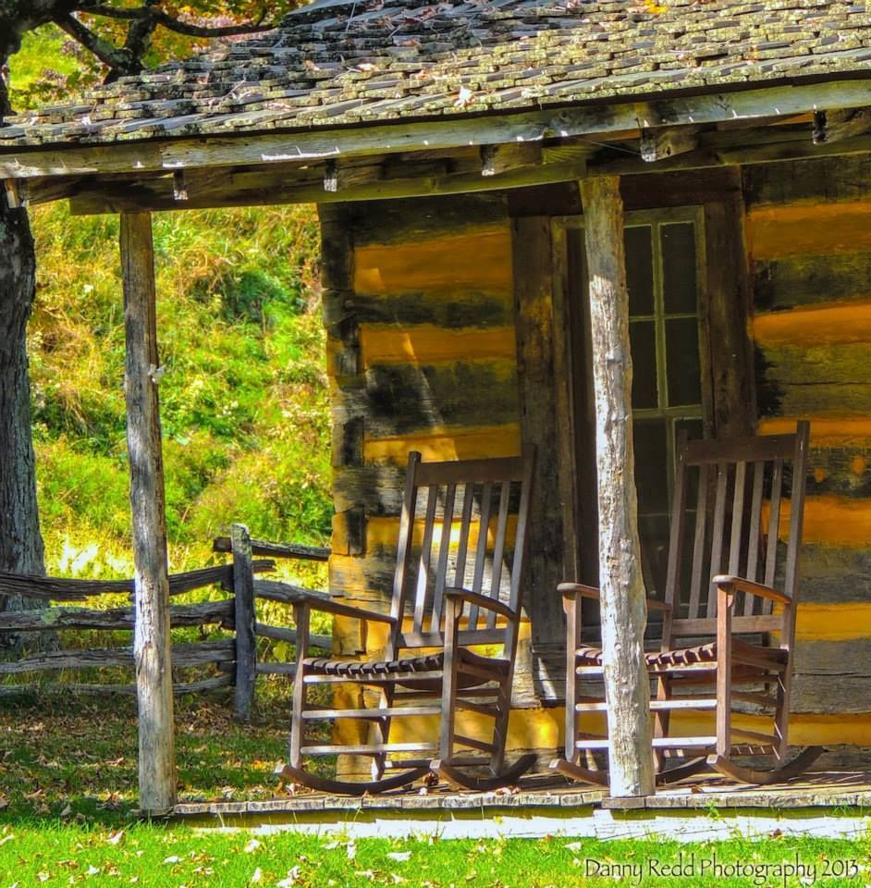
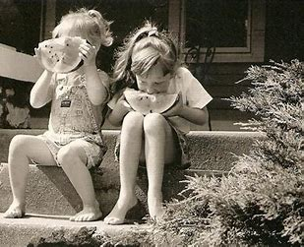
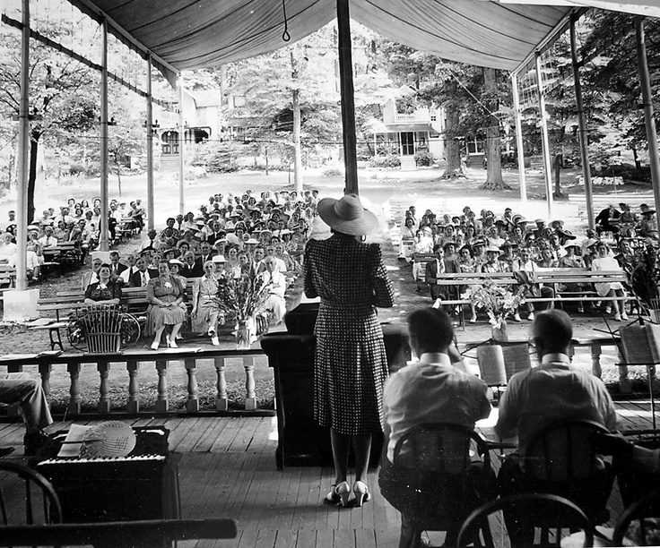
For Black and White Southerners:
What We All Had by Dorothy Lee Hansen

Slide 17
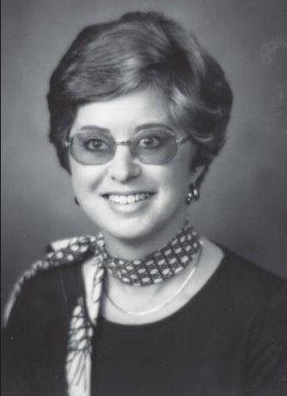
Bigotry,
Nipped in the Bud
Susanne Allen’s Story

Slide 18
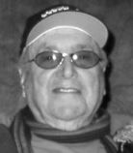

Hearts in Black & White
A Story about Joe Lubin

Slide 19


The Welder by Cherrie Moraga

Slide 20
The Story of John Newton
~Part 3 ~

Slide 21
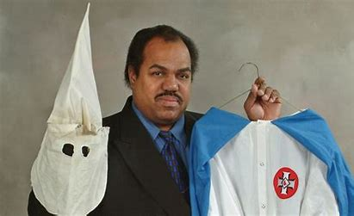
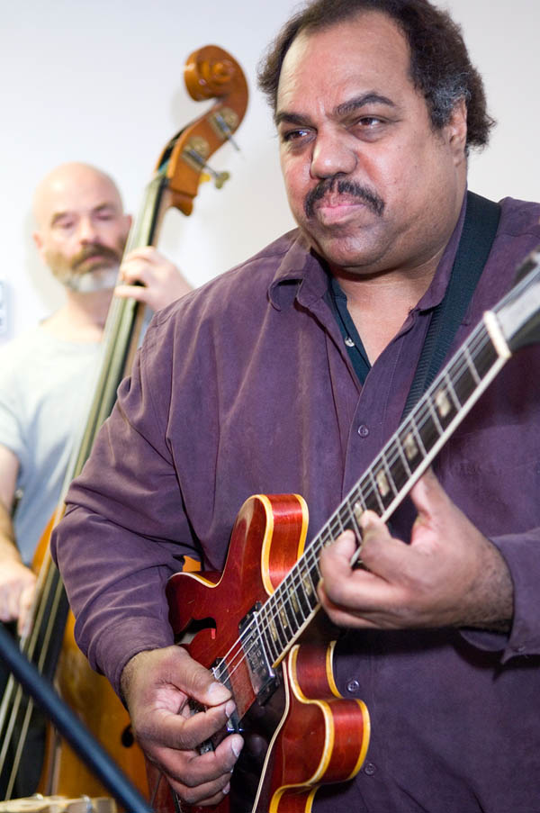
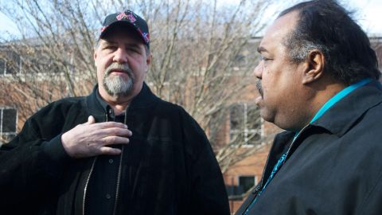
Daryl Davis
The KKK Whisperer
from a CNN Article
by Mallory Simon
and Sara Sidner
Billy Snuffer and Daryl Davis

Slide 22
Amazing Grace
By John Newton

