Slide 1

The Book of Certitude
The Main Theological Principles
Marco Oliveira

Slide 2
Agenda
Introduction
Historical Background
Main Theological Principles:
    God
    The Manifestations of God
    The Human Being
Signs of a New Revelation

Slide 3
Introduction (1)
The Book of Certitude (The Kitáb-i-Íqán) is the 2nd most important book of the Bahá'í Writings.
It was revealed by Baha’u’llah in Baghdad, in January 1861.
The Book of Certitude is a work of exegesis, where non-transparent passages of the Bible and the Qur’an - parables, figurative speech, and apocalyptic visions - are interpreted and given a new meaning.
The book rationalized the eschatology and became the doctrinal framework for the Bahá'í Faith. It also provided an eschatological bridge into a new religious worldview.

Slide 4
Introduction (2)
The Book of Certitude is also an apology for two eschatological figures: the Báb (as Qá’im) and, in anticipation of Bahá'u'lláh’s own mission, “He Whom God Shall Make Manifest”.
The Book is probably the most widely circulated and influential of all Bahá’í doctrinal works. It was the first Bahá'í text to have an authorized printing.
From an academic perspective, the Book of Certitude is foundational to Bahá'í studies.

Slide 5
Historical Background
“Bahá'u'lláh’s masterful exposition of the one unifying truth underlying all the Revelations of the past.”
(Shoghi Effendi)
Notes:
No human being can comprehend or understand the Supreme Being.
Whatever we imagine or think about Him is the product of our own limited and circumscribed minds.
We can never expect, even for a moment, grasp the reality of our Creator.

Slide 6
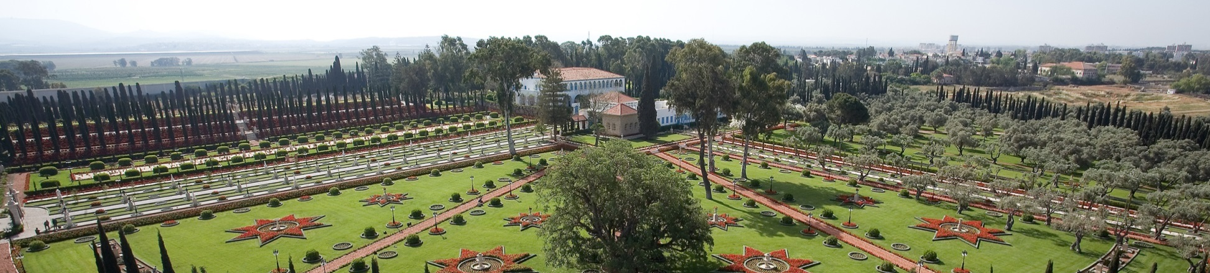
Bahá’u’lláh (1817-1892)
Bahá'u'lláh (born Mírzá Ḥusayn-’Alí Núrí) was the founder of the Bahá'í Faith.
He claimed to be a Manifestation of God and the fulfillment of the eschatological expectations of Islam, Christianity, Bábism, and other major religions.
His teachings focus on the unity of God, unity of religion, and unity of mankind.

Slide 7
Bahá'u'lláh’s life
Baha'u'llah's life has been divided into four stages by Shoghi Effendi:
1817–44 -- wealth and ease and “solicitude for the interests of the poor”
1844–52 -- conversion and “discipleship”
1852 -- imprisonment
1852–1892 -- ministry (several exiles):
    Baghdad (1853-1863)
    Constantinople/Adrianople (1863-68);
    ‘Akká (1868-1892)

Slide 8
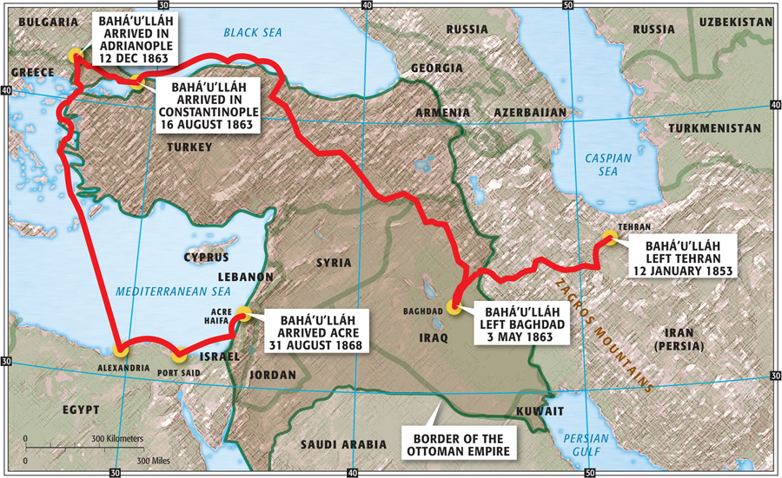
Exiles of Bahá'u'lláh

Slide 9

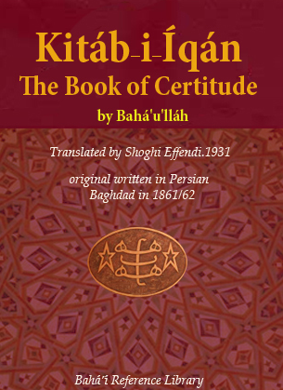


Relevance of the Main Bahá’í Writings
Legislative
Doctrinal
Ethical
Mystical
Notes:
“Indeed, even though the works of Bahá’u’lláh currently published in English
comprise about two thousand pages, there are at least forty thousand manuscript
pages of his writings which have not yet been translated or published in
any Western language.”22

Slide 10
The Báb (1819-1850)
In May 1844, a young Persian man from Shiraz proclaimed Himself to be a new Messenger of God. He assumed the title of Báb ("Gate") and proclaimed to be the Qá’im. He also stated that a new messianic figure - referred to as "He whom God shall make manifest“ - was about to appear.
The Báb’s messianic teachings and His calls for a spiritual and moral reformation were considered heresy by Islamic clergy.
The Bábís faced hostility from the clergy and repression from the Persian government.
Thousands were killed and, in 1850, the Báb was shot by a firing squad in Tabriz.

Slide 11
Family of the Báb (Afnáns)
Hájí Mírzá Sayyid Muhammad (1798-1876) | Also known as Khál-i Akbar (the Great Uncle) Lived in Shiraz; he was the oldest of the uncles. Raised the Báb; admired his Nephew. Visited Bahá’u’lláh in Baghdad; received the Kitáb-i-Iqán. Became a Bahá'í in 1867.
Hájí Mírzá Siyyid `Alí (18??-1850) | Also known as Khál-i-A'zam (the Most Great Uncle) When the Báb's father died, Khál-i-A'zam assumed the guardianship of the Báb and His mother. Became a Bábí in June 1845. He was the one of the Seven Martyrs of Tehran.
Hájí Mírzá Hassan `Alí | Also known as Khál-i-Asghar (the Youngest Uncle) Converted in the late 1860s. Lived and died in Yazd.
Fátimih Bagum, (Mother of the Báb) (????-1881) | Married Siyyid Muhammad-Ridá, from Shíráz The only child to live to adulthood was Siyyid 'Alí-Muhammad (the Báb). Moved to Iraq after the martyrdom of the Báb.

Slide 12
The Great Uncle
The eldest uncle of the Báb admired his nephew. But he could not believe that the Báb could be the Promised One of Islam.
In 1861 he traveled to Karbilá, Iraq, to visit his sister, and then went to Baghdad to meet Bahá'u'lláh.
There Bahá'u'lláh invited him to write down his doubts and questions concerning the appearance of the Promised One.
In the course of most two days and two nights, the Book of Certitude was revealed in answer to those questions (January 1861).

Slide 13
Questions from the Great Uncle
The Day of Resurrection: Will it be corporeal? How will the just be recompensed and the wicked dealt with?
The Twelfth Imám: How can traditions attesting his occultation be explained?
Qur’anic Interpretation: How can the literal meaning of scripture be reconciled with the interpretations current among Bábís?
Advent of the Qá’im: How can the apparent non-fulfillment of popular Imámí traditions concerning the Resurrection be explained?

Slide 14
If the Uncle were Christian…
Day of Resurrection: Will it be corporeal? How will the just be recompensed and the wicked dealt with? (it would be the same question)
Church, Tradition and Dogmas: This cause seems to be in contradiction with the Church tradition and dogmas. How can these be explained?
Bible Interpretation: How can the literal meaning of scripture be reconciled with the interpretations current among Bábís? (it would be the same question)
The Return of Christ: How can the prophecies about the Return of Christ be explained?
Notes:
It is interesting to see that in the Íqán we can find answers to almost all these questions (the 2nd would require other sources).

Slide 15
Outline of the Book of Certitude
Exhortation (¶1-2)
The rejection of the Prophets of the past and its cause (¶3-17)
Explanation of verses revealed to the Prophets of old (¶18-88)
The objections of the divines and the people in every age and century (¶88-98)
Closing passages to Part One (¶99-101)
Prologue (¶102)
The sovereignty of the Manifestations (¶103-146)
The continuity of Divine Revelation (¶147-160)
The twofold station of the Manifestations (¶161-210)
The prerequisites of the true seeker: the path to divine knowledge (¶211-219)
The Word of God as the greatest proof of the Manifestations (¶220-245)
Specific proofs connected to the Revelation of the Báb (¶246-275)
Closing passages to Part Two (¶276-290)

Slide 16
Style of the Book of Certitude
The Book of Certitude was translated to English in 1931, by Shoghi Effendi.
Shoghi Effendi describes the Book’s style as "a model of Persian prose, of a style at once original, chaste and vigorous, and remarkably lucid, both cogent in argument and matchless in its irresistible eloquence" (God Passes By, 138-139).
For Westerners the style of the Íqán may seem difficult: the absence of chapters (the book has two parts), the intertwining of themes, and the Islamic terminology may be challenges.

Slide 17
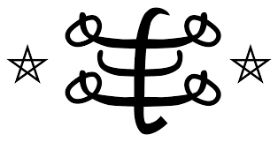
Three Main Themes
There are many possible ways to describe the content and the themes of the Book of Certitude.
On this presentation we will focus on three main themes:
    God
    The Manifestations of God
    The Human Being

Slide 18
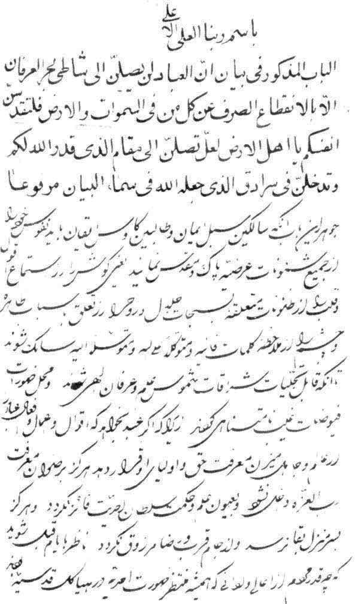
Original Manuscript
The opening page of the original manuscript of the Kitáb-i-Íqán in the handwriting of 'Abdu'l-Bahá, produced in 1278 A.H. (1861-62 C.E.)
From the webpage Symbol and Secret, Christopher Buck.
http://bahai-library.com/buck_symbol_secret_quran

Slide 19
God
“Far be it from His glory that human tongue should adequately recount His praise, or that human heart comprehend His fathomless mystery.” (¶104)
Notes:
No human being can comprehend or understand the Supreme Being.
Whatever we imagine or think about Him is the product of our own limited and circumscribed minds.
We can never expect, even for a moment, grasp the reality of our Creator.

Slide 20
The concept of God
Like in other monotheistic religions, God is described as transcendent, imperishable, uncreated, and source of all existence.
The Book of Certitude “proclaims unequivocally the existence and oneness of a personal God, unknowable, inaccessible, the source of all Revelation, eternal, omniscient, omnipresent and almighty” (Shoghi Effendi, God Passes By, 139).
Although religions and cultures have different concepts of God and His nature, Bahá'ís believe they nevertheless refer to one and the same Being. These differences are seen as reflective of the varying needs of the societies in which the divine messages were revealed.
Notes:
What is meant by personal God is a God Who is conscious of His creation, Who has a Mind, a Will, a Purpose, and not, as many scientists and materialists believe, an unconscious and determined force operating in the universe. Such conception of the Divine Being, as the Supreme and ever present Reality in the world, is not anthropomorphic, for it transcends all human limitations and forms, and does by no means attempt to define the essence of Divinity which is obviously beyond any human comprehension. To say that God is a personal Reality does not mean that He has a physical form, or does in any way resemble a human being. To entertain such belief would be sheer blasphemy.

Slide 21
Unknowable Essence
God, the unknowable Essence, the divine Being, is immensely exalted beyond every human attribute, such as corporeal existence, ascent and descent, egress and regress. (¶104)
To imagine a Supreme Being in a mortal frame, no matter how exalted, is to create for God a limiting and restricting form.
The Infinite can not become finite. If it could, it would no longer be Infinite.
In another Tablet, Bahá'u'lláh adds: “Know thou of a certainty that the Unseen can in no wise incarnate His Essence and reveal it unto men.” (Gleanings from the Writings of Bahá’u’lláh, XX)
Notes:
The Infinite can not become finite. If it could, it would no longer be Infinite.
Negative theology: speak only in terms of what may not be said about the perfect goodness that is God.

Slide 22
Source of everything
No sign can indicate His presence or His absence; inasmuch as by a word of His command all that are in heaven and on earth have come to exist, and by His wish… all have stepped out of utter nothingness into the realm of being, the world of the visible. (¶104)
The presence or existence of God is not obvious.
Believing in the existence of God as the main source of everything that exists is an act of free will, a way to understand reality.

Slide 23

No direct tie…
No tie of direct intercourse can possibly bind Him to His creatures. He standeth exalted beyond and above all separation and union, all proximity and remoteness. (¶104)
This doesn’t mean that the material world is completely separate from the Creator.
Everything that exists in the universe is a reflection of God.
And God makes His will known through His Messengers.

Slide 24

Creation reflects the Creator
…all things, in their inmost reality, testify to the revelation of the names and attributes of God within them. Each according to its capacity, indicateth, and is expressive of, the knowledge of God... (¶109)
Although the creation has no direct link to the essence of the Creator, it reflects the attributes of the Creator.
Notes:
“Some people, in order to discover God, read books. But there is a great book: the very appearance of created things. Look above you! Look below you! Read it. God, whom you want to discover, never wrote that book with ink. Instead, He set before your eyes the things that He had made. Can you ask for a louder voice than that?”
― Augustine of Hippo

Slide 25
Some Titles of God in the Íqán
The Exalted (inv.)
The Most High (inv.)
the All-Glorious (¶2, ¶12, ¶18)
the Unseen (¶3)
the Almighty (¶8)
The All-Bountiful (¶14)
Providence (¶1, ¶14)
the Lord of all beings (¶14)
the Well-Beloved (¶15, ¶22)
the Eternal (¶16)
the true One, the Adored (¶31)
the divine Charmer (¶61)
the All-Merciful (¶65)
the Creator of all names and attributes (¶20)
the Ancient of Days (¶106)
the Source of infinite grace (¶106)
the unchangeable Being (¶106)
imperishable Essence (¶106)
the central Orb of the universe (¶106)
the Invisible of the Invisibles (¶109)
Primal Will (¶129)
the Mover of all beings (¶132)
the Dominant (134)
The King of eternal glory (¶147)
the Lord of Lords (¶170)
the All-Pervading, the Incorruptible (¶196)

Slide 26
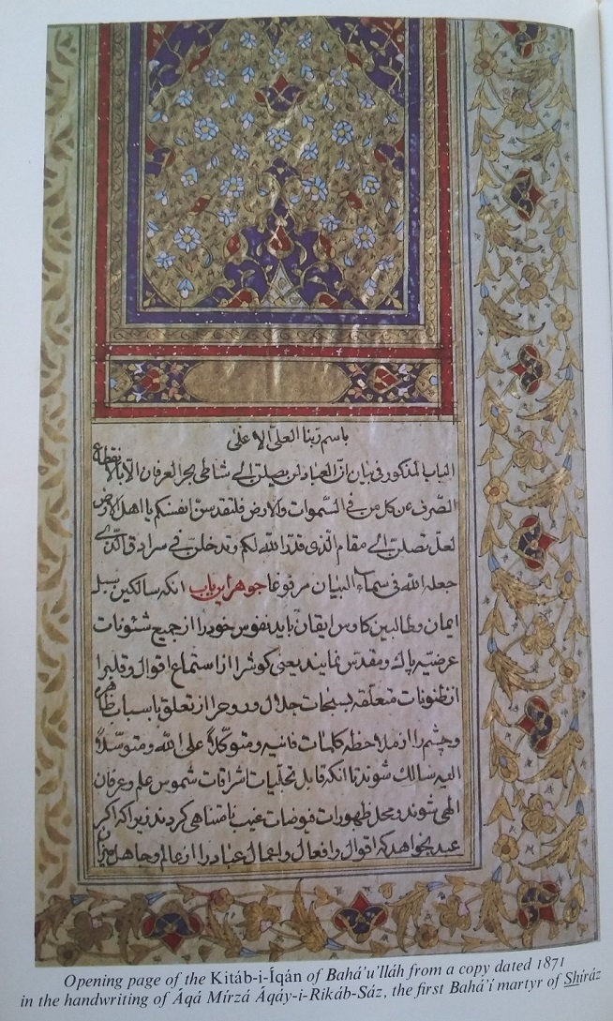
1871 Edition
Opening page of the Kitáb-i-Íqán (dated from 1871) in the hand writing of Áqá Mirzá Áqáy-i-Rikáb-Sáz, first martyr from Shíráz
From Bahá’u’lláh, The King of Glory, Hasan Balyuzi.

Slide 27
The Manifestations of God
“These Prophets and chosen Ones of God are the recipients and revealers of all the unchangeable attributes and names of God. They are the mirrors that truly and faithfully reflect the light of God.” (¶151)
Notes:
These Prophets and chosen Ones of God are the recipients and revealers of all the unchangeable attributes and names of God. They are the mirrors that truly and faithfully reflect the light of God. Whatsoever is applicable to them is in reality applicable to God, Himself, Who is both the Visible and the Invisible. (161)

Slide 28
The Manifestations of God
While God's essence is inaccessible, a subordinate form of knowledge of God is available through knowledge of the divine messengers, known as Manifestations of God.
Religion, according to Bahá'u'lláh, is renewed periodically by Manifestations of God, people who are made perfect through divine intervention and whose teachings are the sources of the major world religions throughout history.
In the Book of Certitude, Bahá'u'lláh advanced what might be thought of as a theory of religious relativity.

Slide 29
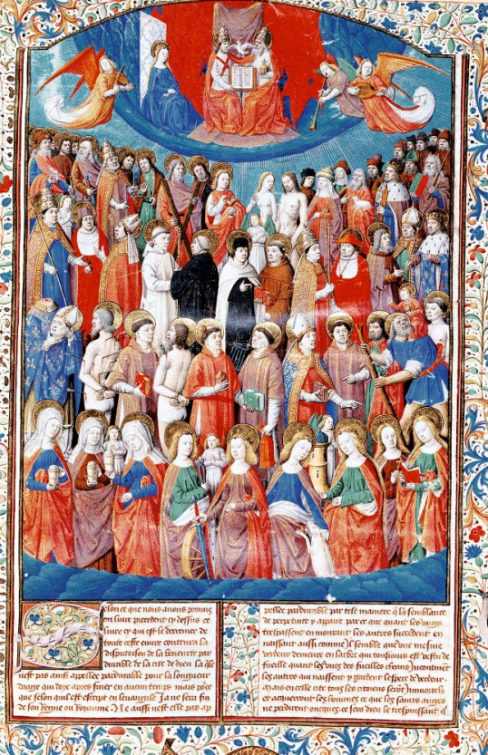
Progressive Revelation
Religious truth is revealed by God progressively and cyclically over time through a series of divine Messengers, and their teachings are tailored to suit the needs of the time and place of their appearance.
Bahá'u'lláh says that the "City of God" - i.e., the Divine Revelation - will be "renewed and readorned" about every thousand years(¶218).
The doctrine of progressive revelation is central to the Bahá'í theology and metaphysics.
Notes:
The Bahá'í teachings recognize the divine origin of several world religions as different stages in the history of one religion, while believing that the revelation of Bahá'u'lláh is the most recent (though not the last—that there will never be a last), and therefore the most relevant to modern society.

Slide 30
The Manifestations of God
All Manifestations of God have similar lives:
They appear in times of moral and spiritual decadence.
Their appearance is not noticed.
Their teachings calls for a moral and spiritual reformation.
They face opposition from the clergy and political power.
They announced that another Manifestation would appear (or that they would return).
They are persecuted and sometimes killed.
Eventually their message prevails and is accepted.
Notes:
Manifestations of God mentioned in the Book of Certitude:
Hud
Saleh
Abraham
Joseph
Moses
David
Christ
Muhammad
Báb

Slide 31
Oneness of Manifestations
Inasmuch as these Birds of the Celestial Throne are all sent down from the heaven of the Will of God, and as they all arise to proclaim His irresistible Faith, they therefore are regarded as one soul and the same person. (¶161)
We have to recognize all Messengers of God.
If a person rejects one Messenger of God, than he/she rejects all Messengers.
All or nothing
Notes:
Furthermore, it is evident to thee that the Bearers of the trust of God are made manifest unto the peoples of the earth as the Exponents of a new Cause and the Bearers of a new Message. Inasmuch as these Birds of the Celestial Throne are all sent down from the heaven of the Will of God, and as they all arise to proclaim His irresistible Faith, they therefore are regarded as one soul and the same person. For they all drink from the one Cup of the love of God, and all partake of the fruit of the same Tree of Oneness. (¶161)

Slide 32
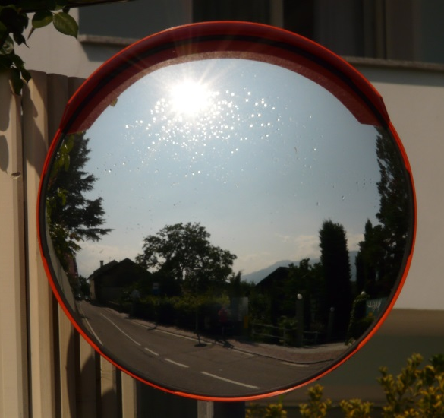
A connection to God
Therefore, whosoever ... hath recognized and attained unto the presence of these glorious, these resplendent and most excellent Luminaries, hath verily attained unto the "Presence of God" Himself, and entered the city of eternal and immortal life. (¶151)
The Manifestations of God are the mirrors of divine attributes and the supreme reflection of divine Truth in the realm of created reality.
Notes:
Furthermore, it is evident to thee that the Bearers of the trust of God are made manifest unto the peoples of the earth as the Exponents of a new Cause and the Bearers of a new Message. Inasmuch as these Birds of the Celestial Throne are all sent down from the heaven of the Will of God, and as they all arise to proclaim His irresistible Faith, they therefore are regarded as one soul and the same person. For they all drink from the one Cup of the love of God, and all partake of the fruit of the same Tree of Oneness. (¶161)

Slide 33
A twofold station
One is the station of pure abstraction and essential unity. In this respect, if thou callest them all by one name, and dost ascribe to them the same attribute, thou hast not erred from the truth. (¶161)
The other is the station of distinction, and pertaineth to the world of creation and to the limitations thereof. In this respect, each Manifestation of God hath a distinct individuality, a definitely prescribed mission, a predestined Revelation... (¶191)
Notes:
Furthermore, it is evident to thee that the Bearers of the trust of God are made manifest unto the peoples of the earth as the Exponents of a new Cause and the Bearers of a new Message. Inasmuch as these Birds of the Celestial Throne are all sent down from the heaven of the Will of God, and as they all arise to proclaim His irresistible Faith, they therefore are regarded as one soul and the same person. For they all drink from the one Cup of the love of God, and all partake of the fruit of the same Tree of Oneness. (¶161)
It is clear and evident to thee that all the Prophets are the Temples of the Cause of God, Who have appeared clothed in divers attire. If thou wilt observe with discriminating eyes, thou wilt behold them all abiding in the same tabernacle, soaring in the same heaven, seated upon the same throne, uttering the same speech, and proclaiming the same Faith. (162)

Slide 34
A twofold station
Essential
Unity
Distinction

Slide 35
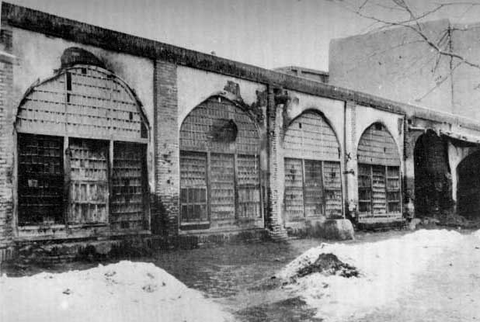
Opposition and persecution
Moreover, consider the hardships and the bitterness of the lives of those Revealers of the divine Beauty. Reflect, how single-handed and alone they faced the world and all its peoples, and promulgated the Law of God! (¶47)
The Manifestations of God always face opposition from the clergy and the people.
They are persecuted and sometimes killed.
Notes:
Furthermore, it is evident to thee that the Bearers of the trust of God are made manifest unto the peoples of the earth as the Exponents of a new Cause and the Bearers of a new Message. Inasmuch as these Birds of the Celestial Throne are all sent down from the heaven of the Will of God, and as they all arise to proclaim His irresistible Faith, they therefore are regarded as one soul and the same person. For they all drink from the one Cup of the love of God, and all partake of the fruit of the same Tree of Oneness. (¶161)

Slide 36
A twofold language
One language, the outward language, is devoid of allusions, is unconcealed and unveiled; that it may be a guiding lamp and a beaconing light whereby wayfarers may attain the heights of holiness, and seekers may advance into the realm of eternal reunion. (¶283)
The other language is veiled and concealed, so that whatever lieth hidden in the heart of the malevolent may be made manifest and their innermost being be disclosed. (¶283)
Notes:
Furthermore, it is evident to thee that the Bearers of the trust of God are made manifest unto the peoples of the earth as the Exponents of a new Cause and the Bearers of a new Message. Inasmuch as these Birds of the Celestial Throne are all sent down from the heaven of the Will of God, and as they all arise to proclaim His irresistible Faith, they therefore are regarded as one soul and the same person. For they all drink from the one Cup of the love of God, and all partake of the fruit of the same Tree of Oneness. (¶161)

Slide 37
A twofold language
Outward language
(devoid of allusions,
unconcealed and unveiled)
Inner language
(veiled and concealed)

Slide 38
New interpretations
Bahá'u'lláh logically demonstrates the existence of figurative language in the Scriptures, based on absurdities that result from literal readings.
And He presents several interpretations for symbolic descriptions and terms found in the New Testament and in the Qur’an.
To demonstrate the concept of progressive revelation, Bahá'u'lláh explains the meaning of concepts like “resurrection,” “return of a Prophet,” “sovereignty” and “Seal of the Prophets.”
His exegesis exposes the consistency, coherence, and evolution of religion as a single process.
Notes:
The Book of Certitude warns that the real meaning of the Scriptures are accessible only to the Manifestations of God and their appointed successors.
No human interpretation can legitimately be used as standard to access the claim of the new Manifestation.

Slide 39
“Resurrection”
…whosoever in every dispensation is born of the Spirit (John 3:5-7) and is quickened by the breath of the Manifestation of Holiness, he verily is of those that have attained unto "life" and "resurrection" and have entered into the "paradise" of the love of God. (¶125)
It hath been demonstrated and definitely established, through clear evidences, that by "Resurrection" is meant the rise of the Manifestation of God to proclaim His Cause, and by "attainment unto the divine Presence" is meant attainment unto the presence of His Beauty in the person of His Manifestation. (¶182)
Notes:
…by "trumpet" is meant the trumpet-call of Muhammad's Revelation, which was sounded in the heart of the universe, and by "resurrection" is meant His own rise to proclaim the Cause of God. (123)
The Day of Return or Day of resurrection mentioned in the Qur’an is tipicaly understood literaly, meaning the end of history.
But the Kitáb-i-Íqán describes it as part of the spiritual journey and the return of human beings to God. This Day of Return occurs when the Manifestation appears; this occurs for each and every Manifestation of God.
There is no such thing as a linear view of life and society culminating in a end of history.
On the contrary, history is dynamic, progressive and non-linear. Social advancement is achieved through a sequence of qualitative new stages of spiritualization.

Slide 40
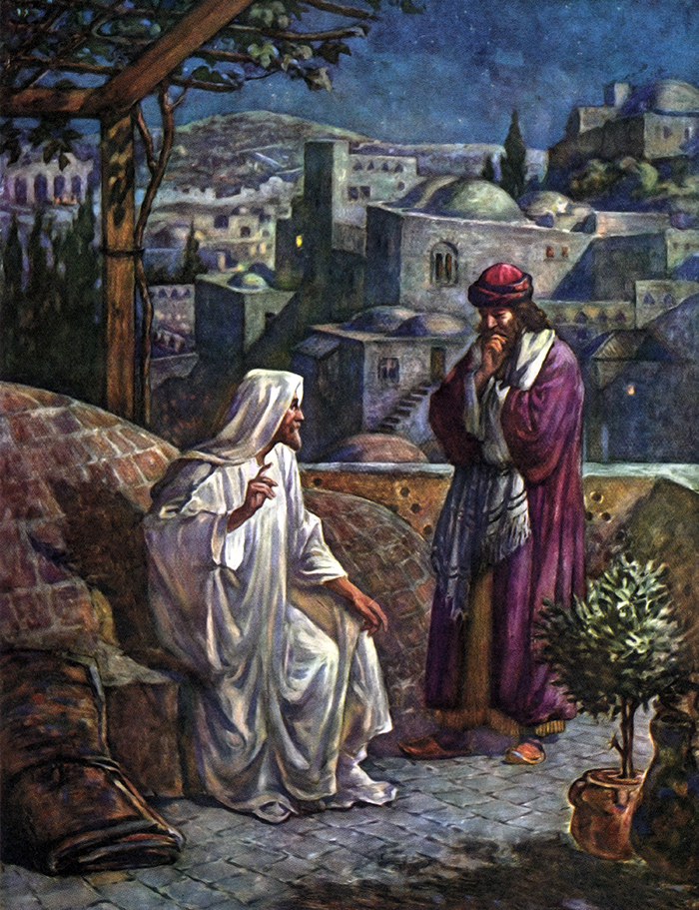
“Resurrection”
Jesus and Nicodemus, by William Hole
Jesus answered, Verily, verily, I say unto thee, Except a man be born of water and of the Spirit, he cannot enter into the kingdom of God.
That which is born of the flesh is flesh; and that which is born of the Spirit is spirit.
Marvel not that I said unto thee, Ye must be born again.
(John 3:5-7)

Slide 41
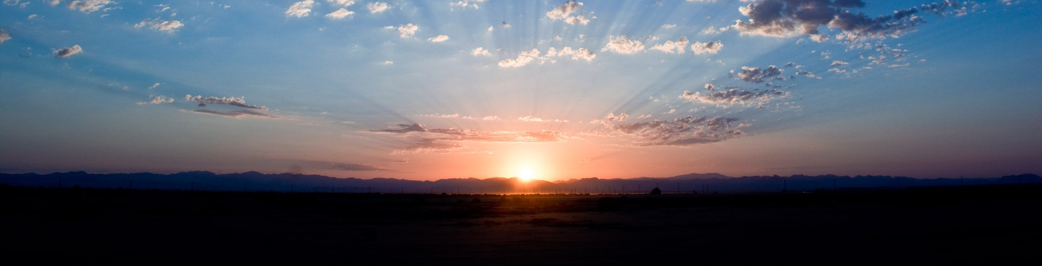
“Return of a Prophet”
….the Point of the Bayán [the Báb] … likened the Manifestations of God unto the sun which, though it rise from the "Beginning that hath no beginning" until the "End that knoweth no end," is none the less the same sun. Now, wert thou to say, that this sun is the former sun, thou speakest the truth; and if thou sayest that this sun is the "return" of that sun, thou also speakest the truth. (¶171) (see also: Mt 17:10-12)
Notes:
The Manifestations are the return of one another, despite the differences in their physical human or situational characteristics.
They can be considered as the same person visiting humanity from time to time.

Slide 42
“Sovereignty”
Is this sovereignty which, through the utterance of one Word, hath manifested such pervading influence, ascendancy, and awful majesty, is this sovereignty superior, or is the worldly dominion of these kings of the earth who, despite their solicitude for their subjects and their help of the poor, are assured only of an outward and fleeting allegiance, while in the hearts of men they inspire neither affection nor respect? Hath not that sovereignty, through the potency of one word, subdued, quickened, and revitalized the whole world? (¶131)
Notes:
Each revelation initiated by a Manifestation of God initiates a new cycle of resurrection and rebirth.

Slide 43

“Seal of the Prophets”
And were they all to proclaim: "I am the Seal of the Prophets," they verily utter but the truth, beyond the faintest shadow of doubt. For they are all but one person, one soul, one spirit, one being, one revelation. They are all the manifestation of the "Beginning" and the "End, "the "First" and the "Last," the "Seen" and "Hidden"… (¶196)
…the people of the Qur'án, like unto the people of old, have allowed the words "Seal of the Prophets" to veil their eyes. (¶237)

Slide 44
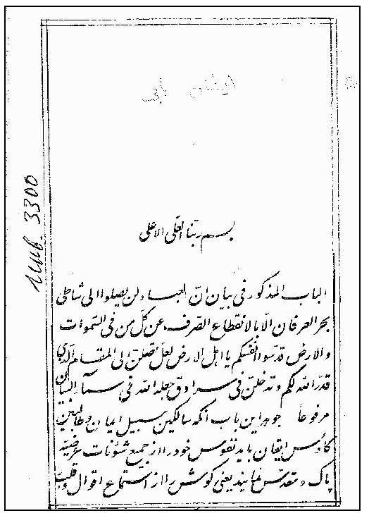
1893 Bombay Lithograph
Kitáb-i-mustaṭáb-i-íqán (Bombay: Náṣirí Press, 1310/1892–1893), the first dated lithograph of the Íqán, calligraphed by Mishkín-Qalam, nasta‘líq, 214 pages.
There are only three copies of this edition known to still exist.
From the book Symbol and Secret, Christopher Buck.

Slide 45
The Human Being
“For in him are potentially revealed all the attributes and names of God to a degree that no other created being hath excelled or surpassed. All these names and attributes are applicable to him.” (¶107)
Notes:
No human being can comprehend or understand the Supreme Being.
Whatever we imagine or think about Him is the product of our own limited and circumscribed minds.
We can never expect, even for a moment, grasp the reality of our Creator.

Slide 46
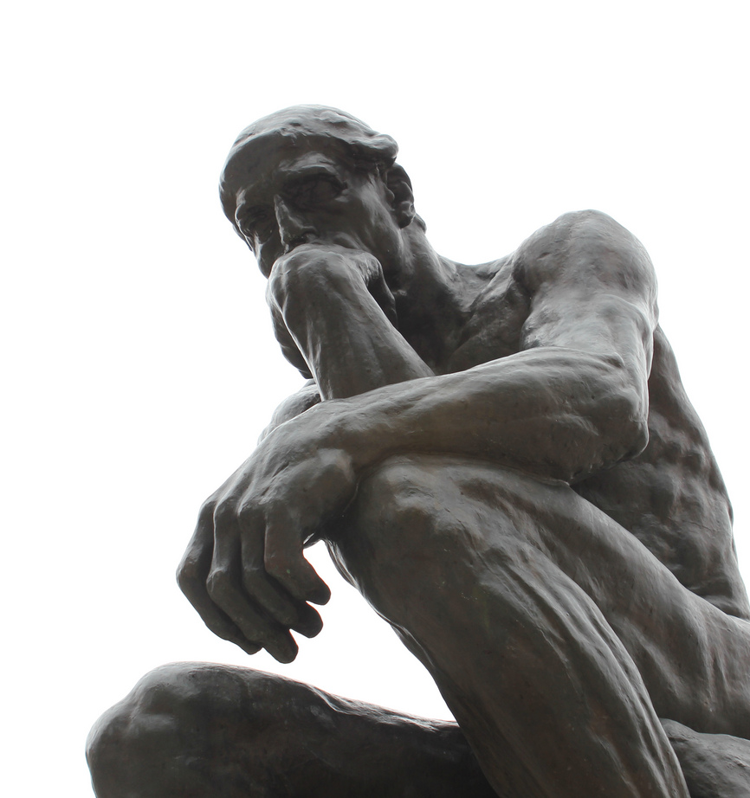
The Human Being
The Bahá'í writings state that human beings have a "rational soul," and that this provides them with a unique capacity to recognize God and humanity's relationship with its Creator.
The purpose of human life is to develop the potential within each human being, to manifest as many of the divine attributes as possible and to try to perfect these.

Slide 47
A Supreme Degree…
How resplendent the luminaries of knowledge that shine in an atom, and how vast the oceans of wisdom that surge within a drop! To a supreme degree is this true of man, who, among all created things, hath been invested with the robe of such gifts, and hath been singled out for the glory of such distinction. (¶107)
Everything in creation manifests some aspect of God.
But the human being is the only entity to have the potential to manifest all of the attributes of God.
Notes:
How resplendent the luminaries of knowledge that shine in an atom, and how vast the oceans of wisdom that surge within a drop! To a supreme degree is this true of man, who, among all created things, hath been invested with the robe of such gifts, and hath been singled out for the glory of such distinction. For in him are potentially revealed all the attributes and names of God to a degree that no other created being hath excelled or surpassed. All these names and attributes are applicable to him. Even as He hath said: "Man is My mystery, and I am his mystery." (¶107)

Slide 48
The Deep Questions
Human beings have a twofold nature:
  a spiritual nature, which will survive death and is thus eternal;
  a physical nature, which human beings share with animals and which ends with death.
The Íqán answers some deep questions concerning the purpose of human life:
  How can we know God?
  How can we have access to Divine knowledge?
  What are the requirements to attain such knowledge?

Slide 49


A transformative knowledge
For a religious person these are some of the most crucial concerns in life.
Knowledge of God also deals with the concern about the purpose of creation and the ultimate meaning of human existence.
Unlike ordinary knowledge which does not affect the subject in any significant way, the recognition of the Manifestation of God is a knowledge that by its nature is creative, transformative and ecstatic.

Slide 50
Expectation and Rejection
How often have they expected His coming, how frequently have they prayed that the breeze of divine mercy might blow, and the promised Beauty… be made manifest to all the world. And whensoever the portals of grace did open, and the clouds of divine bounty did rain upon mankind, and the light of the Unseen did shine above the horizon of celestial might, they all denied Him, and turned away from His face. (¶3)
Humans pray for and expect a Messiah but persecute Him when He appears.
Notes:
For the highest and most excelling grace bestowed upon men is the grace of "attaining unto the Presence of God" and of His recognition, which has been promised unto all people. This is the utmost degree of grace vouchsafed unto man by the All-Bountiful, the Ancient of Days, and the fulness of His absolute bounty upon His creatures. (¶148)

Slide 51
Detachment from all…
No man shall attain the shores of the ocean of true understanding except he be detached from all that is in heaven and on earth. (¶1)
Preconceived ideas are an obstacle to understand and recognize the Divine message.
History of religions shows that the majority of the first persons to recognize the Manifestations of God were not the educated or the most preeminent in their time.
The spiritual requirements for a true seeker to acquire Divine Knowledge are described in the Íqán.

Slide 52
Never seek to exalt himself…
He must never seek to exalt himself above any one, must wash away from the tablet of his heart every trace of pride and vainglory, must cling unto patience and resignation, observe silence, and refrain from idle talk. For the tongue is a smouldering fire, and excess of speech a deadly poison. Material fire consumeth the body, whereas the fire of the tongue devoureth both heart and soul. (¶213)
(…)
In the Kitáb-i-Íqán, Bahá'u'lláh presents the eschaton within a moral framework, rather than political one.
Notes:
For the highest and most excelling grace bestowed upon men is the grace of "attaining unto the Presence of God" and of His recognition, which has been promised unto all people. This is the utmost degree of grace vouchsafed unto man by the All-Bountiful, the Ancient of Days, and the fulness of His absolute bounty upon His creatures. (¶148)

Slide 53
Moral Reform
He should succour the dispossessed, and never withhold his favour from the destitute… He should not wish for others that which he doth not wish for himself, nor promise that which he doth not fulfil. With all his heart should the seeker avoid fellowship with evil doers, and pray for the remission of their sins. He should forgive the sinful, and never despise his low estate, for none knoweth what his own end shall be. (¶214)
Bahá'u'lláh made moral reform a precondition to the realization of the eschaton, the anticipated apocalypse.
Notes:
For the highest and most excelling grace bestowed upon men is the grace of "attaining unto the Presence of God" and of His recognition, which has been promised unto all people. This is the utmost degree of grace vouchsafed unto man by the All-Bountiful, the Ancient of Days, and the fulness of His absolute bounty upon His creatures. (¶148)

Slide 54
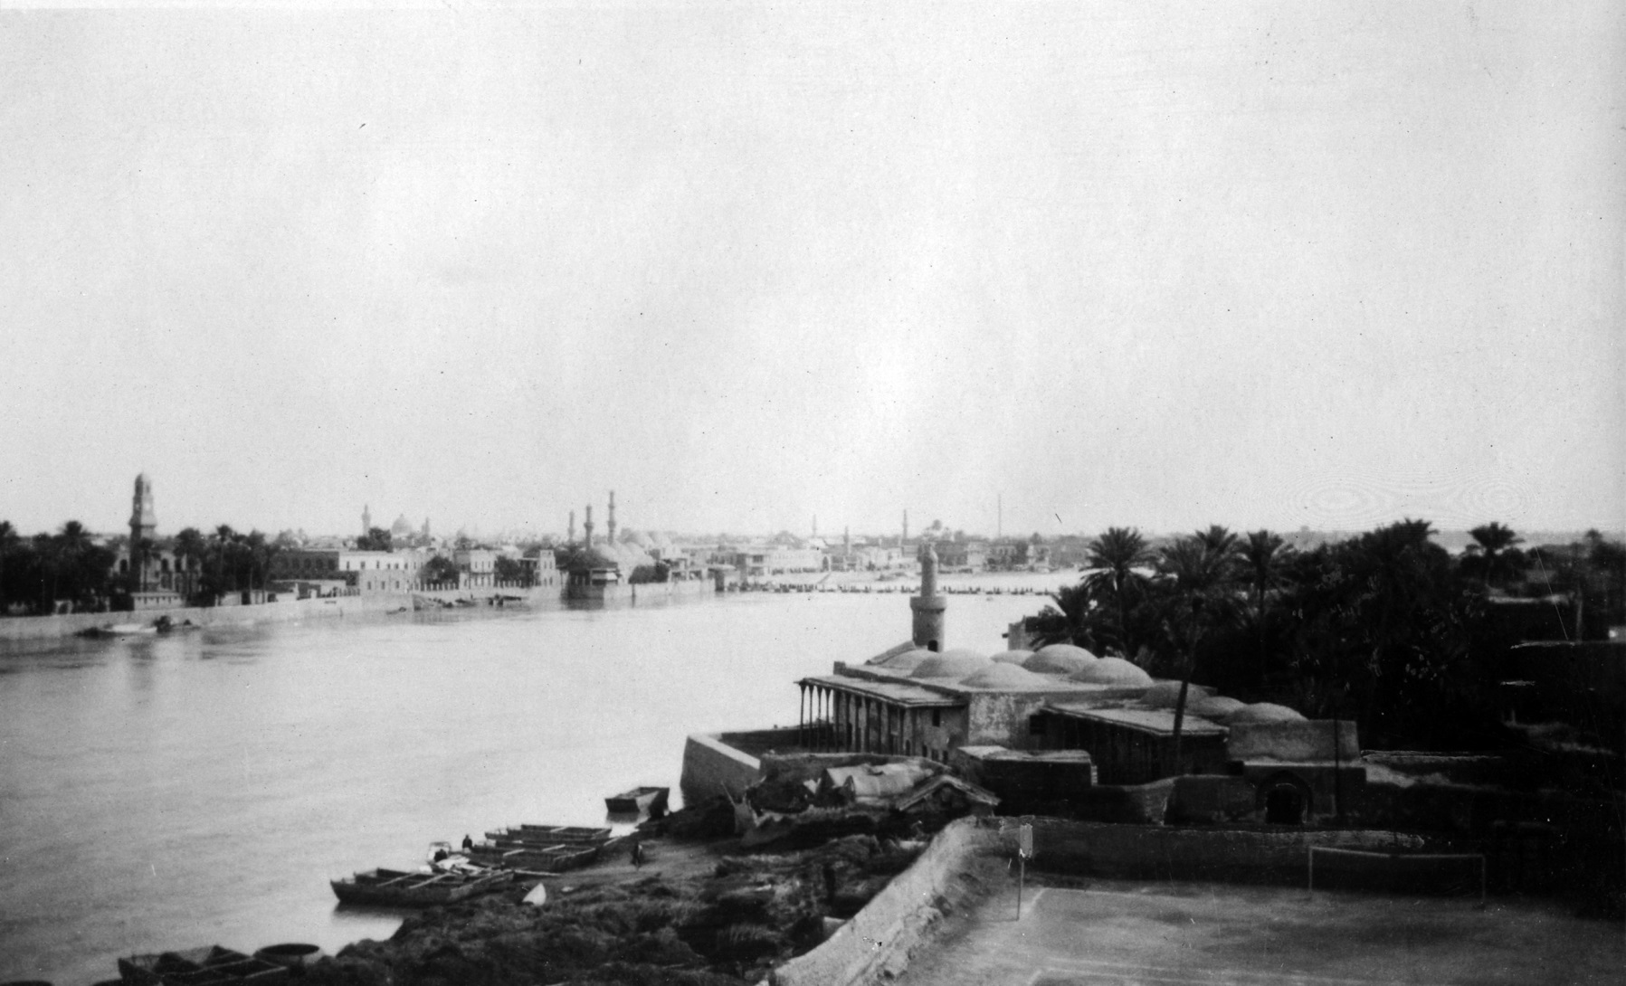
Baghdad, 19th Century

Slide 55
Signs of a new Revelation
“Such are the strains of celestial melody which the immortal Bird of Heaven, warbling upon the Sadrih of Bahá, poureth out upon thee, that, by the permission of God, thou mayest tread the path of divine knowledge and wisdom.” (¶85)
Notes:
No human being can comprehend or understand the Supreme Being.
Whatever we imagine or think about Him is the product of our own limited and circumscribed minds.
We can never expect, even for a moment, grasp the reality of our Creator.

Slide 56
Introduction
In the Kitáb-i-Íqán, Bahá'u'lláh elucidates and interprets the Writings of the past. He prepares the Bábís for a messianic figure who would fulfill a radically redefined eschaton.
The Book of Certitude can be seen as advance legitimation for Bahá'u'lláh’s own prophetic credentials.
The Book of Certitude is also an apology for two eschatological figures: the Báb (as Qá’im) and Bahá'u'lláh (“He Whom God Shall Make Manifest”).
In some passages in the Íqán, Bahá'u'lláh uses figurative language to announce the imminence of His own revelation.

Slide 57
Every single note
By God! This Bird of Heaven, now dwelling upon the dust, can, besides these melodies, utter a myriad songs, and is able, apart from these utterances, to unfold innumerable mysteries. Every single note of its unpronounced utterances is immeasurably exalted above all that hath already been revealed, and immensely glorified beyond that which hath streamed from this Pen. Let the future disclose the hour when the Brides of inner meaning will, as decreed by the Will of God, hasten forth, unveiled, out of their mystic mansions, and manifest themselves in the ancient realm of being.(¶190)

Slide 58
Waters of Everlasting Life
This wronged One will cite but one of these instances, thus conferring upon mankind, for the sake of God, such bounties as are yet concealed within the treasury of the hidden and sacred Tree, that haply mortal men may not remain deprived of their share of the immortal fruit, and attain to a dewdrop of the waters of everlasting life which, from Baghdád, the “Abode of Peace,” are being vouchsafed unto all mankind. (¶22)
These reference to His words as “waters of everlasting life which, from Baghdád, the “Abode of Peace,” are being vouchsafed unto all mankind” is also an indication of the divine nature of His Words.

Slide 59
Quote from Hidden Words
“O Son of Man! Many a day hath passed over thee whilst thou hast busied thyself with thy fancies and idle imaginings. How long art thou to slumber on thy bed? Lift up thine head from slumber, for the Sun hath risen to the zenith; haply it may shine upon thee with the light of beauty.” (¶254)
In the Íqán, there is only one quote from the Hidden Words. And this quote can be understood as a veiled declaration.
The exhortation to awaken because the sun has risen is a clear allusion to the Arabic Bayán, in which the Bab speaks of the Promised One as the rising of the Sun to its “zenith,” as well as the heedlessness of the people.

Slide 60
In this later Revelation…
“By His references to their opposition He intended to invalidate the objections which the people of the Bayán might raise in the day of the manifestation of “Mustagháth,” the day of the Latter Resurrection, claiming that, whereas in the Dispensation of the Bayán a number of divines have embraced the Faith, in this latter Revelation none of these hath recognized His claim. (¶256)
Mustagháth -- He Who shall be invoked. This is another name for the Bábí messiah, “He Whom God Shall Make Manifest”.

Slide 61
Final Paragraphs
Revealed by the “Bá’” and the “Há’.”
Peace be upon him that inclineth his ear unto the melody of the Mystic Bird calling from the Sadratu’l-Muntahá! (¶288-289)
Note that the term “revealed” appears in Bahá'u'lláh’s own colophon.
This suggests that Bahá’u’lláh considered the text to be “revealed” and therefore He is a Manifestation of God.

Slide 62
Bibliography
Bahá’u’lláh: Kitáb-i-Íqán , 2d ed. (Wilmette, Ill.: Bahá’í Publishing Trust, 1950)
Buck, Christopher: “Kitáb-i-Íqán : An Introduction to Bahá'u'lláh's Book of Certitude with Two Digital Reprints of Early Lithographs” at http://www.h-net.org/~bahai/bhpapers/vol2/iqan&sn.htm.
Buck, Christopher: Symbol and Secret (Los Angeles , Cal.: Kalimat Press, 2004)
Buck, Christopher: “Beyond the ‘Seal of the Prophets’: Bahā’u’llāh’s Book of Certitude (Ketāb-e Iqān)” (2007) at https://www.academia.edu/20339629/_Beyond_the_Seal_of_the_Prophets_Bah%C4%81_u_ll%C4%81h_s_Book_of_Certitude_Ket%C4%81b-e_Iq%C4%81n_2007_
Fananapazir, Khazeh and Fazel, Seena: “The Station of the Kitáb-i-Íqán” at https://bahai-library.com/fananapazir_fazel_station_iqan.
Lawson, Todd: “The Bahá’í Tradition: The Return of Joseph and the Peaceable Imagination,” 135–157, at https://courses.wilmetteinstitute.org/pluginfile.php/40326/mod_page/content/17/Lawson%20The%20Return%20of%20Joseph.pdf.
Phelps, Steven: “Outline of the Kitáb-i-Íqán” at https://courses.wilmetteinstitute.org/pluginfile.php/40360/mod_resource/content/1/Iqan%20outline%20-%20sdp.pdf.
Rabbani, Ahang: "The Conversion of the Great Uncle of the Bab” at http://bahaistudies.net/bahaiworks/Conversion_of_the_Great_Uncle_of_the_Bab.pdf.
Saiedi, Nader: Logos and Civilization (Bethesda, Md.: University Press of Maryland, 2000)

Slide 63
Acknowledgements
This presentation was the formal project for the The Kitáb-i-Íqán: An Introduction, 2017 course, from Wilmette Institute.
Special thanks to the faculty members Christopher Buck and Necati Alkan for the guidance, encouragement, suggestions, and comments.
Special thanks to Robert Stockman for the comments, patience and support.
Marco Oliveira
63

Slide 64
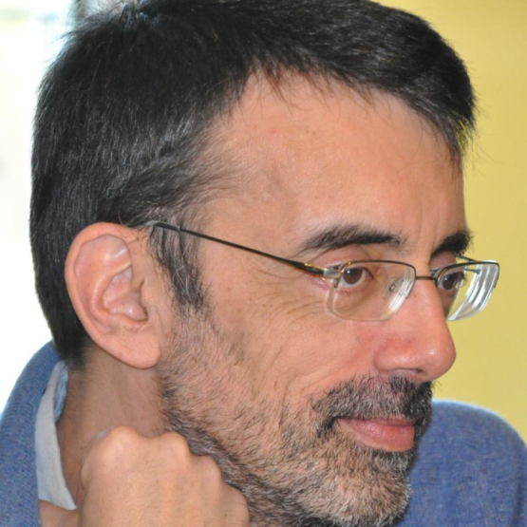
Marco Oliveira
http://www.facebook.com/Marco.Oliveira.PT
http://povodebaha.blogspot.com/
http://www.youtube.com/user/marco1963
http://www.scribd.com/Marco_Oliveira
Notes:
No human being can comprehend or understand the Supreme Being.
Whatever we imagine or think about Him is the product of our own limited and circumscribed minds.
We can never expect, even for a moment, grasp the reality of our Creator.

